Slide 1
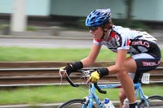
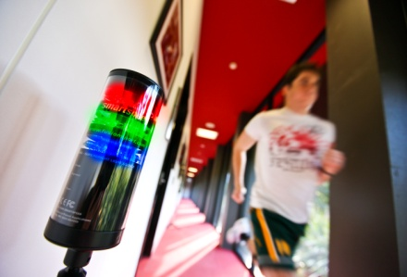
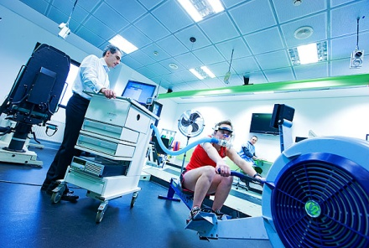
Welcome to the
School of Exercise and Nutrition Sciences
in the Faculty of Health
Congratulations on your success in achieving a place in the H343 Bachelor of Exercise and Sport Science or
D394 Bachelor of Exercise and Sport Science/
Bachelor of Business (Sport Management)
This presentation is available at:
www.deakin.edu.au/health/ens/currentstudents/
Student-enrolment-information.php

Slide 2
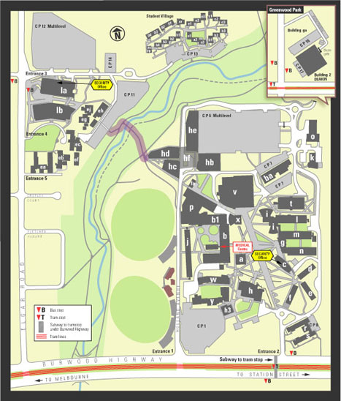
School of Exercise and Nutrition Sciences
Where to find us…
Building J
Reception Level 3

Slide 3
School of Exercise and Nutrition Sciences
H343 Bachelor of Exercise and Sport Science
The course consists of 24 credit points over 3 years full-time study.
You may only study 10 Level 1 credit points towards your degree.
During your course you are required to complete 10 elective units. A maximum of 8 credit points may be selected from other faculties of the University, subject to quotas, and your timetable and
2 credit points must be from the Faculty of Health.
A compulsory practicum unit is completed in year 3
(HSE312 – Exercise and Sport Science Practicum).

Slide 4
School of Exercise and Nutrition Sciences
H343 Bachelor of Exercise and Sport Science
Sample course grid
YEAR 1 | TRI 1 | Introduction to Exercise and Sport Science Practice HSE103 | Human Structure and Function HBS109 | Principles of Exercise and Sport Science HSE101 | Major Sequence/ Elective
 | TRI 2 | Health Information and Data HBS108 | Health Behaviour HBS110 | Functional Human Anatomy HSE102 | Major Sequence/ Elective
YEAR 2 | TRI 1 | Exercise Physiology HSE201 | Exercise Behaviour HSE203 | Hxx Elective unit | Major Sequence/ Elective
 | TRI 2 | Biomechanics HSE202 | Motor Learning and Development HSE204 | Hxx Elective unit | Major Sequence/ Elective
YEAR 3 | TRI 1 | Principles of Exercise Prescription HSE301 | Exercise and Sport Science Practicum 1 HSE312 | Elective | Major Sequence/ Elective
 | TRI 2 | Exercise Programming HSE302 | HSE3xx core elective | Elective | Major Sequence/ Elective

Slide 5
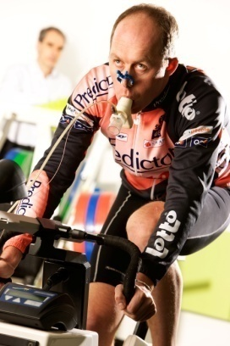
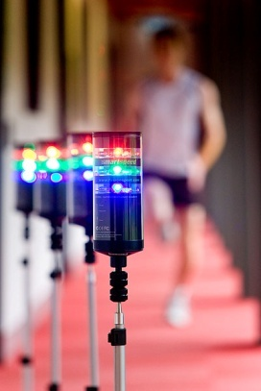
School of Exercise and Nutrition Sciences
Major Sequences
Opportunity to undertake
a major sequence
ESSA Sequence Exercise Physiology
Nutrition or Sports Nutrition Food Studies
Sport Coaching Health Promotion
Physical Activity and Health Psychology
People, Society and Disability Family, Society and Health
You can select majors from across the university, not just from Health.
Refer to the online handbook and majors list provided for more detail.
* You must select your major sequence (‘unit set sequence’) in StudentConnect
when enrolling in your 2014 units. This can be changed at a later date.

Slide 6
School of Exercise and Nutrition Sciences
Major Sequences - Units
SPORTS COACHING
HSE105, HSE106, HSE205
HSE204, HSE305, HSE321
NUTRITION
HBS109, HSN101, HSN201, HSN202, HSN301, HSN302
SPORTS NUTRITION
HSN101, HSN201, HSN202, HSE303, HSN307, HSN305
EXERCISE PHYSIOLOGY
HSE201, HSE208, HSE301
HSE303, HSE304, HSE320
PSYCHOLOGY
HPS111, HPS121, HPS201, HPS202, HPS203, HPS204, HPS205, HPS301, HPS307, HPS308
PHYSICAL ACTIVITY & HEALTH
HBS107, HBS110, HSE203,
HSE212, HSE313, HSE316

Slide 7
School of Exercise and Nutrition Sciences
Exercise Science – ESSA Sequence
Eligible for full membership of Exercise and Sport Science Australia (ESSA) as an Exercise Scientist.
What is the benefit of being recognised as an Exercise Scientist?
Membership with ESSA
Exemption from completing the Certificate 4 in Fitness for Kinect membership
(Physical Activity Australia)
Ability to obtain professional indemnity insurance to work in the fitness industry
Ability to become an Accredited Exercise Physiologist (AEP) with further study
Ability to become an accredited sports scientist with appropriate industry experience
More information is available at the School of Exercise and Nutrition Sciences Careers web site at:
www.deakin.edu.au/health/ens/careers/index.php

Slide 8
School of Exercise and Nutrition Sciences
Certificate III in Fitness accreditation – for H343 students
Students may obtain accreditation with Physical Activity Australia to be able to work as an Exercise Instructor from 2015 onwards.
To be eligible to gain Certificate III in Fitness accreditation at the completion of first year you must enrol in the following units for 2014:
Trimester 1 2014
HSE101 (core unit)
HSE103 (core unit)
HSE105 (elective unit)
Trimester 2 2014
HSE102 (core unit)
Students will also need to have completed a Level 2 First Aid course and have a current CPR certificate during time of registration.
For further information about how to register with Physical Activity Australia,
please visit http://www.physicalactivityaustralia.org.au.

Slide 9
School of Exercise and Nutrition Sciences
D394 Bachelor Of Exercise And Sport Science/
Bachelor Of Business (Sport Management)
The course consists of 32 credit points over 4 years full-time study.
The Bachelor of Exercise and Sport Science comprises 16 credit points: 14 core units and 2 HSE electives at level two or three in year 4.
The Bachelor of Business comprises of 16 credit points, all of which are core units.
There are two compulsory practicum units, one for Exercise and Sport Science and one for Sport Management, both completed in year 4.

Slide 10
School of Exercise and Nutrition Sciences
D394 Bachelor Of Exercise And Sport Science/
Bachelor Of Business (Sport Management)
Sample course grid
YEAR 1 | TRI 1 | Introduction to Exercise and Sport Science Practice HSE103 | Human Structure and Function HBS109 | Accounting for Decision Making MAA103 | Sport Organisation MMS100
 | TRI 2 | Functional Human Anatomy HSE102 | Health Behaviour HBS110 | Sport in Society MMS101 | Business Analytics MIS171
YEAR 2 | TRI 1 | Principles of Exercise and Sport Science HSE101 | Exercise Physiology HSE201 | Fundamentals of Finance MAF101 | Business Law MLC101
 | TRI 2 | Health Information and Data HBS108 | Biomechanics HSE202 | Economic Principles MAE101 | Management MMM132
YEAR 3 | TRI 1 | Exercise Behaviour HSE203 | Principles of Exercise Prescription HSE301 | Business Information Systems MIS101 (Incomp:SIT101) | Marketing Management MMK277
 | TRI 2 | Motor Learning and Development HSE204 | Exercise Programming HSE302 | Business Communication MMH299 | Sport Leadership and Governance MMS313
YEAR 4 | TRI 1 | Exercise and Sport Science Practicum 1 HSE312 OR Applied Sport Science 1 HSE311 | HSE Level 2 or Level 3 Elective | Sport Facility and Event Management MMS307 | Sport and the Law MLC310
 | TRI 2 | Exercise and Sport Science Practicum 1 HSE312 OR Applied Sport Science 2 HSE314 | HSE Level 2 or Level 3 Elective | Sport Practicum MMS306 | Sport Marketing MMS308

Slide 11
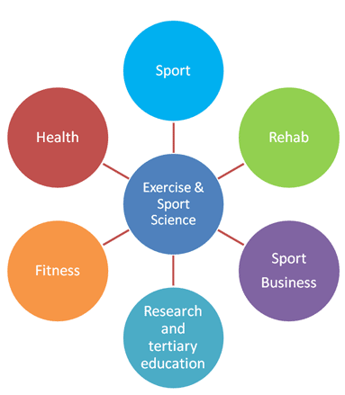
School of Exercise and Nutrition Sciences
Careers Website
www.deakin.edu.au/health/ens/careers/index.php

Slide 12
School of Exercise and Nutrition Sciences
Terminology
Credit for Prior Learning
If you have studied at another tertiary institution and would like to apply for credit for units successfully completed, please complete a credit for prior learning form available at the time of enrolment.
Credit Point
Value of a unit/subject, usually each unit is worth one credit point, some are worth two credit points.
Study Abroad and Exchange
We encourage you to participate in an exchange or study abroad
program in the second year of your studies.

Slide 13
School of Exercise and Nutrition Sciences
Terminology continued…
Trimester
The academic year is divided into three trimesters: First (T1) Second (T2) and Summer (T3).
Trimester 1 classes commence in the week beginning
Monday 10 March 2014.
HSE010 Laboratory Safety Unit
All students are required to enrol in and pass HSE010 Laboratory Safety unit prior to their first laboratory class. Students are only required to complete this once during their degree.
You are required to complete this unit prior to your first lab class for HSE103 in Trimester 1, 2014.

Slide 14
School of Exercise and Nutrition Sciences
Terminology continued…
Unit Code
Each unit, or subject, has a distinct alphanumeric code, for example HSE102.
HSN refers to the School of Exercise and Nutrition Sciences and the 101 indicates
that it is a first year level unit. Second year level units begin with a ‘2’
and third year level units begin with a ‘3’ eg. HSE201 is a second
year level unit and HSE301 is a third year level unit.
Unit Name
Each unit, has a distinct unit name eg. ‘Functional Human Anatomy’

Slide 15
School of Exercise and Nutrition Sciences
Provides social and career networking opportunities to current students and alumni.
Annual Fee $5 DUSA Access Member ($10 Non-DUSA Access)
Membership includes ID card, access to seminars and
monthly e-Newsletter
Website: www.dussc.net
You can also find them on Facebook!

Slide 16
School of Exercise and Nutrition Sciences
Timetable and Class Attendance
Timetable
The University timetable is located on the Deakin Website at the following address:
http://www.deakin.edu.au/timetable
A hardcopy of the Faculty of Health’s timetable will be on the noticeboard outside the Faculty Student and Academic Service, Building Y, Room 101.
Lectures, Tutorials and Practicals
You are expected to attend the tutorials and practicals for all units you are enrolled in.
Lectures for most units are available online if you are unable to attend.

Slide 17
School of Exercise and Nutrition Sciences
STAR – On Campus Timetable
Visit www.deakin.edu.au/star for more information
STAR opens on Monday 10 February at 9:00am
for you to enter preferences for timeslots you would like to attend.
STAR closes on Monday 17 February 2014 at 9:00am.
Preferences are collected, randomised and sorted.
STAR re-opens on Tuesday 18 February at 9:00am and students can view their personalised timetable and make adjustments then.
Most students will be provided with a clash free timetable.
STAR can be accessed from the StudentConnect website at: http://www.deakin.edu.au/studentconnect

Slide 18
School of Exercise and Nutrition Sciences
Online Handbook
To assist you as a student at Deakin, we recommend that you log on to http://www.deakin.edu.au/handbook/2014 and read the information about your course.
We also recommend that you log into the Current Students website at http://www.deakin.edu.au/current-students
There are many handy links on this site which contain vital information on what is involved in being a Deakin student, important dates, the services and facilities available to you and details of your course requirements.
Not all of it may be relevant to you now, but reading these sections will help make your time at Deakin a complete experience.

Slide 19
School of Exercise and Nutrition Sciences
Things to do…
Enrol online via www.deakin.edu.au/studentconnect
for both Tri 1 and Tri 2 2014 by no later than
5:00pm on Monday 3 February 2014 or your offer will lapse.
Complete your eCAF (electronic Commonwealth Assistance Form) to accept your Commonwealth supported place and/or apply for HECS-HELP.
You MUST complete all steps of the Enrolment process and receive a receipt number at Step 5 of 5 – Receipt to confirm that you have successfully enrolled in your course.
Get your student ID card from Deakin Central once enrolled.
Attend the HSE Laboratory Safety Information Session during Orientation Week.

Slide 20
School of Exercise and Nutrition Sciences
Things to do…
If you intend to apply for CPL, please submit applications no later than
28 February 2014 to your course adviser.
Check your timetable and select your preferences on STAR (Student Timetable Allocation and Registration system) from 10 February – 17 February.
STAR can be accessed via DeakinSync, or from the StudentConnect website at: http://www.deakin.edu.au/studentconnect
Ensure personal contact details are always up-to-date
and ensure you check your Deakin email account regularly.

Slide 21
School of Exercise and Nutrition Sciences
Peer Mentoring Program 2014
Excited about starting at Deakin, but unsure of the unfamiliar environment?
Is the prospect of starting university a little bit daunting?
The Faculty of Health offers the Peer Mentoring program to all Health students across all campuses. This program is highly recommended to all commencing students.
Second and third year Health students (mentors) assist new students (mentees) through introduction and transition to university life during the first five weeks of trimester.
Sign up to be a mentee at the following link:
http://www.deakin.edu.au/health/peer-mentoring/forms/mentee.php
You will require your Deakin username and password to sign up.

Slide 22
School of Exercise and Nutrition Sciences
StudentConnect Enrolment Assistance
Enrolment assistance is available at webpage:
http://www.deakin.edu.au/study-at-deakin/apply/enrol-defer-withdraw-or-transfer/enrol-for-the-first-time
Enrolling at Deakin is a simple three-step process. This webpage will step you through this process.
Click the ‘Start the enrolment process in StudentConnect’ video link available on this webpage under Step 2 - Enrol in StudentConnect. This quick 5 minute video provides step-by-step enrolment guidance for StudentConnect.
There is also a “How do I enrol online?” PDF document available to download from the link above to assist in the enrolment process.

Slide 23
School of Exercise and Nutrition Sciences
Orientation Week
3 – 7 March 2014
Wednesday 5 March
10am-12 noon
Compulsory Faculty of Health Information Session (LT13 HC2.005)
Thursday 6 March
9:00am-12 noon
Compulsory Course and Lab Safety Information Session (LT12 X2.05)

Slide 24
School of Exercise and Nutrition Sciences
Contacts H343
Faculty of Health Student and Academic Services
Building Y, Room Y101 Telephone 9251 7777
Course Director: Dr Stuart Warmington
Telephone 9251 7013 or email stuart.warmington@deakin.edu.au
Deputy Course Director: Dr Dan Dwyer
Telephone 5227 3476 or email dan.dwyer@deakin.edu.au
Student Advisers: Mrs Kerry Becchetti
Ms Lisa-Maree Hardwick
Ms Georgina Power
Mrs Carisa Lee
Telephone 9244 5436 or email ens-enquire@deakin.edu.au

Slide 25
School of Exercise and Nutrition Sciences
Contacts D394
Faculty of Health Student and Academic Services
Building Y, Room Y101 Telephone 9251 7777
Course Director: Mrs Helen Brown
Telephone 9244 6327 or email helen.brown@deakin.edu.au
Deputy Course Director: Dr Andrew Dawson
Telephone 9251 7309 or email andrew.dawson@deakin.edu.au
Student Advisers: Mrs Kerry Becchetti
Ms Lisa-Maree Hardwick
Ms Georgina Power
Mrs Carisa Lee
Telephone 9244 5436 or email ens-enquire@deakin.edu.au

