Slide 1
Welcome to our 2015 Brisbane alumni seminar
Global financial trends

Slide 2
A global economic and market outlook
Dr Chris Caton
June 2015

Slide 3
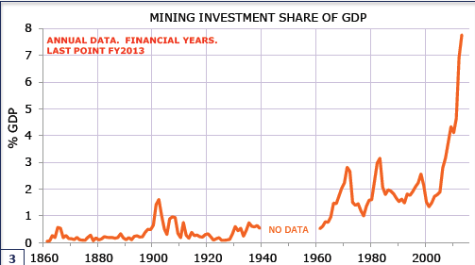
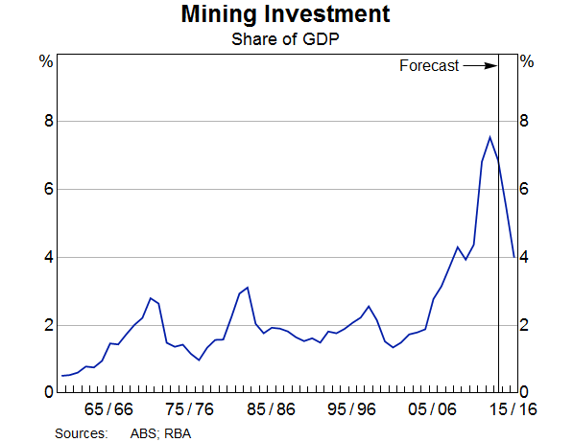
Resources investment (% of GDP)

Slide 4
The terms of trade have come down a long way (index, 2012/13=100)

Slide 5
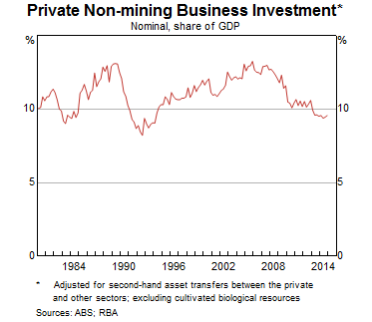
The missing guest at the growth party

Slide 6
2015 Growth Forecasts (%)
Month of Forecast
 | J-14 | A-14 | S-14 | O-14 | N-14 | D-14 | J-15 | F-15 | M-15 | A-15 | M-15 | J-15
Australia | 2.8 | 2.9 | 2.9 | 2.9 | 2.9 | 2.8 | 2.7 | 2.7 | 2.6 | 2.6 | 2.5 | 2.5
New Zealand | 3.0 | 3.0 | 3.0 | 2.9 | 3.0 | 3.0 | 3.1 | 3.0 | 2.9 | 2.9 | 2.9 | 2.9
US | 3.0 | 3.1 | 3.1 | 3.1 | 3.0 | 3.0 | 3.2 | 3.2 | 3.1 | 2.9 | 2.5 | 2.2
Japan | 1.3 | 1.2 | 1.3 | 1.2 | 1.3 | 1.2 | 1.2 | 1.3 | 1.1 | 1.0 | 0.9 | 1.0
China | 7.2 | 7.2 | 7.1 | 7.1 | 7.1 | 7.0 | 7.0 | 7.0 | 7.0 | 6.9 | 6.9 | 6.9
Eurozone | 1.5 | 1.5 | 1.4 | 1.2 | 1.1 | 1.1 | 1.1 | 1.2 | 1.4 | 1.5 | 1.5 | 1.5
UK | 2.6 | 2.6 | 2.6 | 2.6 | 2.6 | 2.6 | 2.6 | 2.7 | 2.7 | 2.6 | 2.5 | 2.4
“World” | 3.2 | 3.3 | 3.2 | 3.2 | 3.1 | 3.0 | 3.0 | 2.8 | 2.8 | 2.7 | 2.6 | 2.5
Source: Consensus Economics

Slide 7
Oil prices generally bounce hard

Slide 8
Financial Market Forecasts
 | Now (12 June) |  |  | End-Dec 2015 | End-Jun 2016
AUD/USD |  | 0.775 | 0.72 |  | 0.70
Official cash rate (%) |  | 2.00 | 2.00 |  | 2.25
10 Year Bond yield (%) |  | 3.15 | 3.20 |  | 3.40
ASX 200 |  | 5545 | 5800 |  | 6000

Slide 9
The Australian Dollar and US Trade Weighted Index
Index
AUD/USD
AUD/USD (RHS)
US TWI inverted (LHS)
Source: Datastream

Slide 10
Volatility has picked up in the exchange rate

Slide 11
Australian Share market Performance – ASX200
Source: Bloomberg

Slide 12
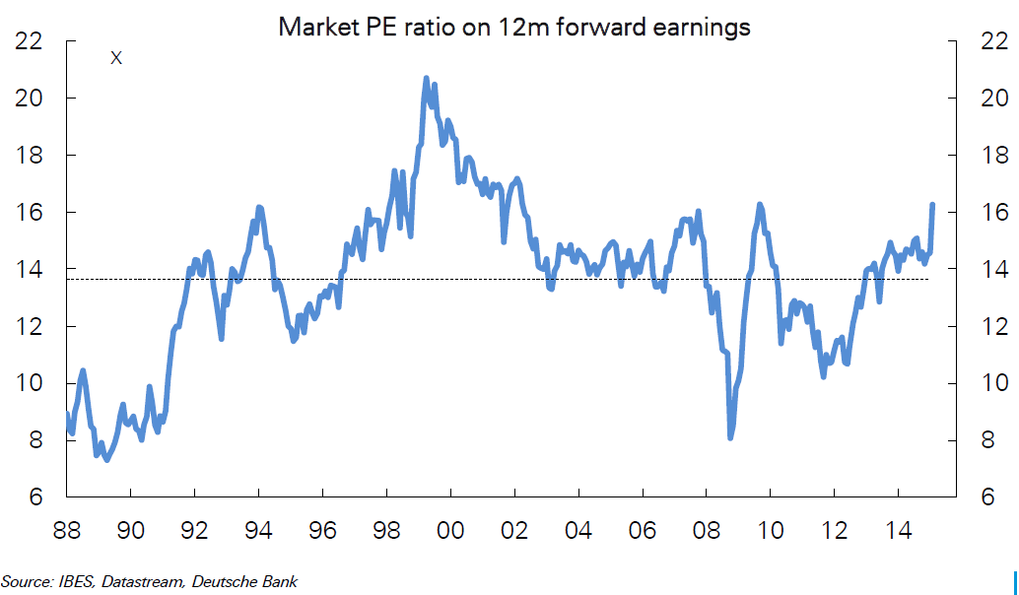
The Australian market is above fair value (forward p/e ratio)

Slide 13
But the P/E tends to be higher when the cash rate is lower

Slide 14
And yields in the share market still beat the alternatives

Slide 15
Share market volatility remains low (no of days in month when ASX200 moves by more than 1%)

Slide 16
Australia has kept pace with the developed world ex US

Slide 17
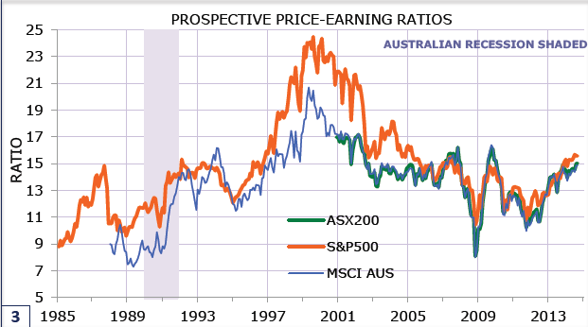
We have been in almost perfect sync with the United States market.

Slide 18
The labour market data are looking a little better. Has unemployment peaked?
000’s
%
Employment (LHS)
Unemployment Rate (RHS)
Source: ABS

Slide 19
Most new jobs are in the service sector

Slide 20
Australian inflation is not an issue
%
BT Forecasts
GST Effect
Source: ABS

Slide 21
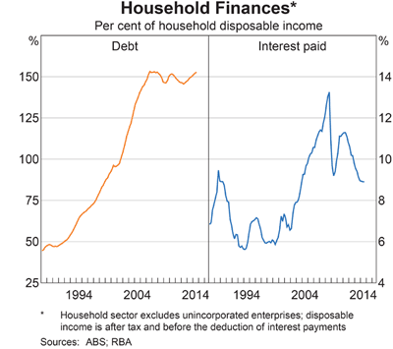
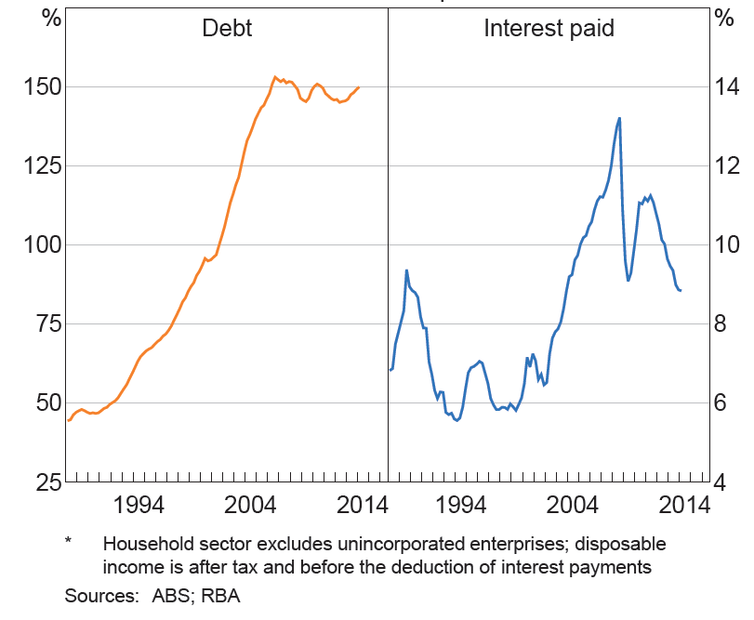
Household financial ratios

Slide 22
House Prices - Australia v Brisbane
Index (1987 = 100)
Source: ABS

Slide 23
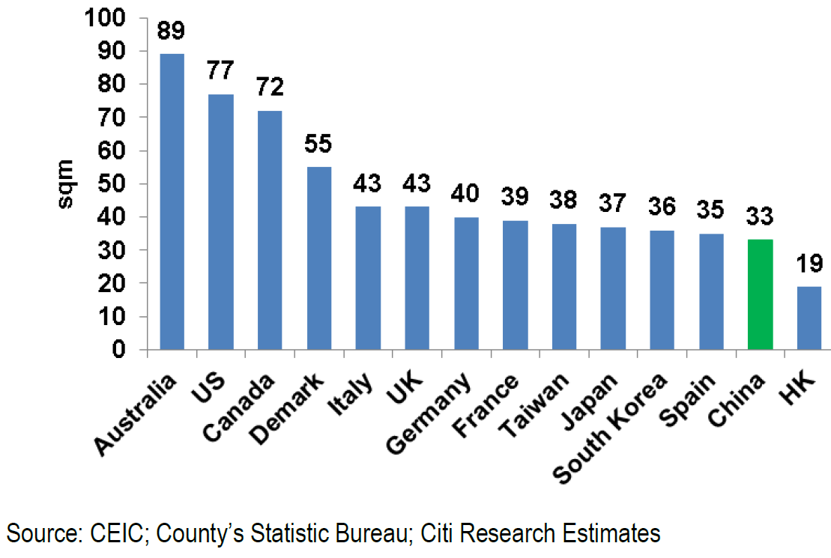
Australian houses are the biggest in the world (sq m per capita)

Slide 24
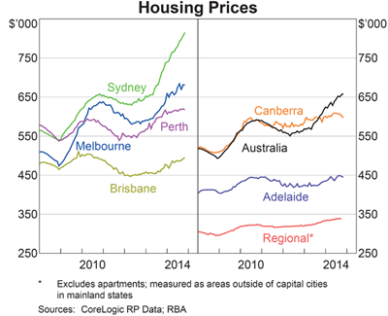
House prices have risen everywhere, particularly in Sydney ($’000s)

Slide 25
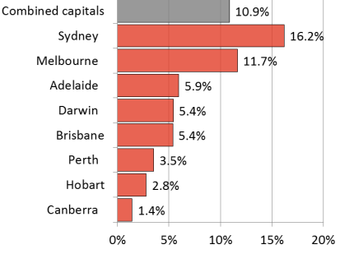
Prices have been rising rapidly in Sydney only in the past year (% increase year to May 2015)

Slide 26
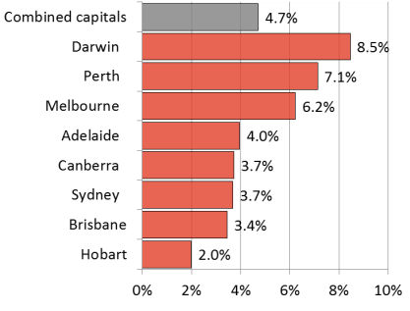
Where’s the bubble? Average house price increase in the past ten years

Slide 27
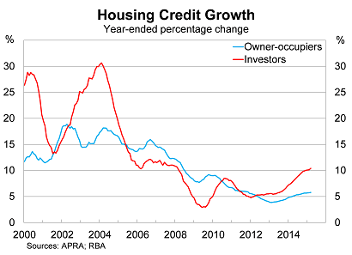

Credit growth has picked up, driven by investors

Slide 28
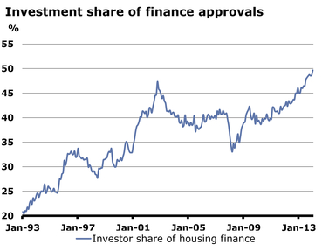
The investors are now in charge

Slide 29
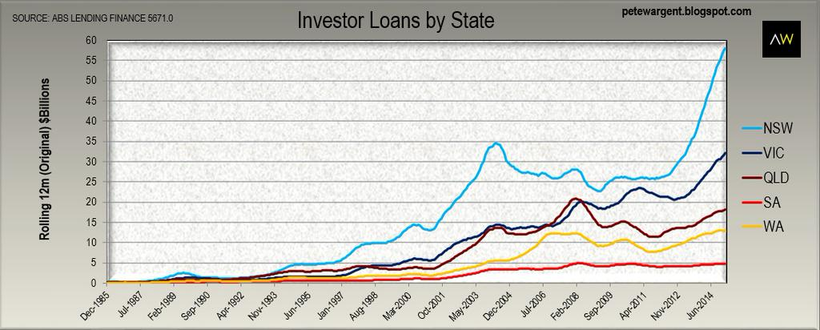
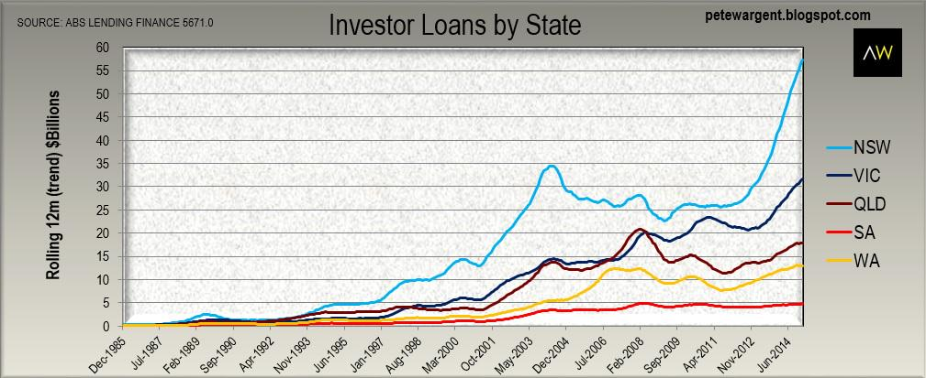
Investors have been piling in in New South Wales

Slide 30
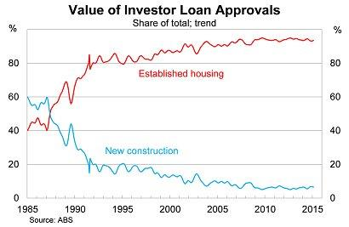
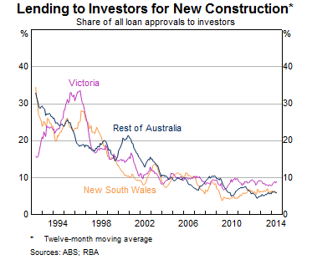
Not much of the borrowing by investors finances new dwellings!

Slide 31
Gross Domestic Product
%
BT Forecasts
Source: ABS

Slide 32
Queensland has lost share

Slide 33
Global Medium-Term Economic Growth and Inflation Prospects (2015-2025)
 | GDP | Inflation
Australia | 2.8 | 2.6
New Zealand | 2.6 | 2.0
United States | 2.5 | 2.0
United Kingdom | 2.3 | 1.9
Sweden | 2.2 | 2.0
Norway | 2.1 | 2.2
Spain | 2.1 | 1.4
Canada | 2.0 | 1.9
Switzerland | 1.5 | 0.9
Netherlands | 1.5 | 1.6
Eurozone | 1.5 | 1.6
Germany | 1.4 | 1.6
France | 1.4 | 1.5
Italy | 1.1 | 1.4
Japan | 1.0 | 1.5
Ss: Consensus Economics

Slide 34
Asia-Pacific Medium-Term Economic Growth and Inflation Prospects (2015-2025)
 | GDP | Consumer Prices
India | 7.4 | 5.2
China | 6.0 | 2.6
Indonesia | 5.6 | 4.8
Philippines | 5.3 | 3.9
Malaysia | 4.7 | 3.2
Thailand | 3.7 | 2.5
Singapore | 3.2 | 1.7
Hong Kong | 2.9 | 2.8
Taiwan | 2.8 | 1.5
Australia | 2.8 | 2.6
South Korea | 2.7 | 2.2
New Zealand | 2.6 | 2.0
Japan | 1.0 | 1.5
Source: Consensus Economics

Slide 35
Summary
The big question in the US is when will rates begin to rise and how quickly?
Growth prospects have improved in the Eurozone.
We will always worry about China.
The Australian economy should continue to experience only moderate growth. The mining investment boom has ended with no significant pickup to date in non-mining capex.
The cash rate may be on hold.
The exchange rate may fall further.
The Australian share market is close to fair value.

Slide 36
Disclaimer
This presentation has been prepared by BT Financial Group Limited (ABN 63 002 916 458) ‘BT’ and is for general information only. Every effort has been made to ensure that it is accurate, however it is not intended to be a complete description of the matters described. The presentation has been prepared without taking into account any personal objectives, financial situation or needs. It does not contain and is not to be taken as containing any securities advice or securities recommendation. Furthermore, it is not intended that it be relied on by recipients for the purpose of making investment decisions and is not a replacement of the requirement for individual research or professional tax advice. BT does not give any warranty as to the accuracy, reliability or completeness of information which is contained in this presentation. Except insofar as liability under any statute cannot be excluded, BT and its directors, employees and consultants do not accept any liability for any error or omission in this presentation or for any resulting loss or damage suffered by the recipient or any other person. Unless otherwise noted, BT is the source of all charts; and all performance figures are calculated using exit to exit prices and assume reinvestment of income, take into account all fees and charges but exclude the entry fee. It is important to note that past performance is not a reliable indicator of future performance.
This document was accompanied by an oral presentation, and is not a complete record of the discussion held.
No part of this presentation should be used elsewhere without prior consent from the author.
For more information, please call BT Customer Relations on 132 135 8:00am to 6:30pm (Sydney time)

Slide 37
Thank you
questions

