Slide 1
WELCOME MELBOURNE ALUMNI TO OUR SEMINAR
Superfoods or Supermyths?
Presented by
Associate Professor Tim Crowe
School of Exercise and Nutrition Sciences
Deakin University
2 March 2016

Slide 2

On Today’s Menu
What is behind the branding of foods as ‘super’?
Superfood wins and fails
Top foods to consume
Tips for a varied diet

Slide 3
What is a ‘Superfood’?
A food with a high phytonutrient content (e.g. antioxidants, fibre, selenium, omega-3s etc.) that may offer health benefits
No legal definition
Has no meaning among nutrition scientists
More an over-used marketing tool

Slide 4

Coconut Oil: The Magic Elixir

Slide 5
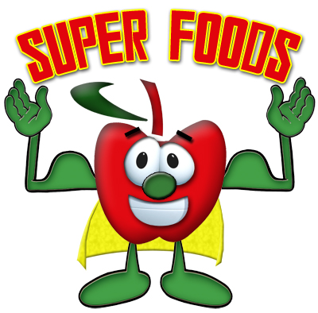
Common ‘Superfoods’
Blueberries
Pomegranates
Wheatgrass
Goji
Noni
Mangosteen
Açai
Chia seeds
Broccoli
Garlic
Pumpkin seeds
Tea
Soy
Coconut oil
Spirulina
Quinoa

Slide 6
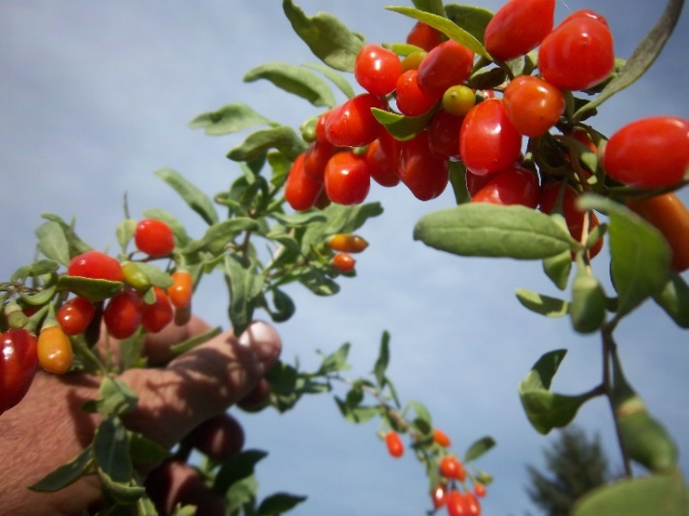
Goji
Claims they have the highest level of vitamin C of all plants (up to 500 times an orange!)
‘18 amino acids’
‘Life extension’ claims
Can interfere with
blood-clotting medications
and increase bleeding risk

Slide 7
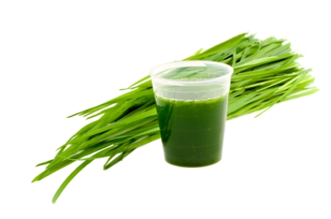
Wheatgrass
Claims: Blood cleanser and ‘detoxifier’
attributed to the 'natural plant enzymes‘
and the chlorophyll content
Common claim that a shot is equivalent to a kilogram of vegetables is a complete myth
Floret of broccoli, or tablespoon of spinach, contain more folate and vitamin C than 30 mL of wheatgrass juice
Chlorophyll not absorbed by the body, requires sunlight for activation, and its supposed high levels are no higher than other green vegetables

Slide 8
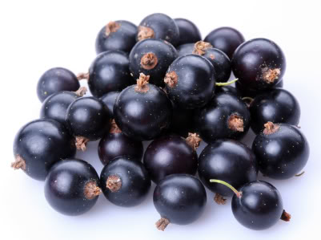
Acai
Cherry-sized purple berry fruit of the acai palm
Lab studies suggest it may have anti-cancer and anti-inflammatory effects, as well as a possible use in treating heart disease
Limited human studies on its health effects
‘It is a poster child of the power of the Internet to promote products for which only limited phytochemical and pharmacological information is available’
Heinrich M et al. Phytochemistry Letters 2011;4:10-21

Slide 9
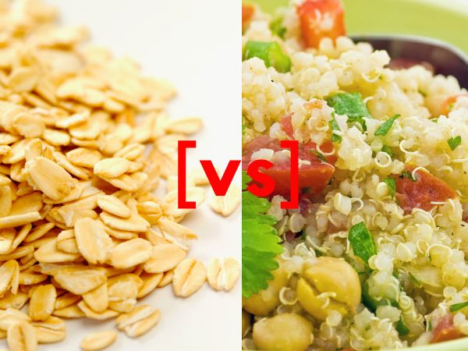
Oats vs Quinoa
 | Oats | Quinoa
Kilojoules | 1634 kJ | 1546 kJ
Protein | 17 g | 14 g
Fat | 7 g | 6 g
Carbohydrate | 66 g | 64 g
Fibre | 11 g | 7 g
Minerals | Similar | Similar
Gluten-free | ? | Yes
Complete protein | No | Yes
Cost | $ | $$$
USDA National Nutrient Database www.ars.usda.gov

Slide 10
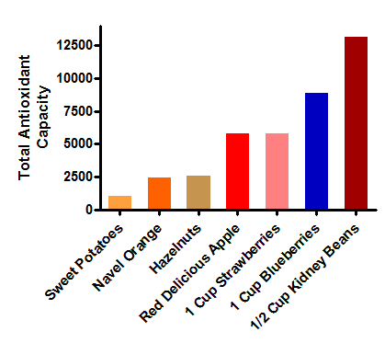
Antioxidants
Total antioxidant capacity (TAC) measured using ORAC (oxygen radical absorbance capacity) test
Wu et al. J Agric Food Chem. 2004;52:4026-4037

Slide 11
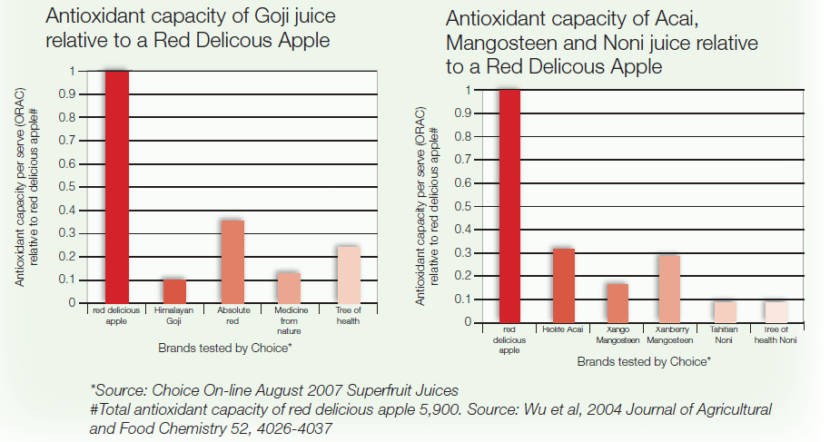
An Apple a Day

Slide 12
Why buy them?
‘Superfruit’ juices contain a range of nutrients, but marketing spin vastly exaggerates their health benefits
Typically sold at high cost through multi-level marketing
Until better scientific evidence arises, cheaper and wiser to get antioxidants from ‘traditional’ fruit and vegetable sources
Since July 2007, marketing of products as ‘superfoods’ is prohibited in the EU unless accompanied by a specific medical claim supported by credible scientific research

Slide 13
Top Foods to Consume
Literally thousands of natural chemicals in foods that can affect our health
There is no one ‘superfood’
Think ‘super diets’ instead
Rather than focus on the effect of a single nutrient, focus on the total effect of food to health

Slide 14
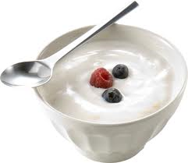
10. Yoghurt
Great source of calcium
Low in fat and high quality protein
Source of ‘good’ bacteria
‘Reduced-fat’ yoghurt may have more calories than regular yoghurt – check the labels!

Slide 15
9. Tomatoes
Contain a powerful antioxidant – lycopene
Found in red/orange coloured fruit and veggies
May offer protection against prostate cancer
Cooking makes the lycopene more available to the body (especially with a small amount of oil)

Slide 16
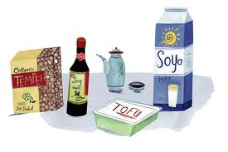
8. Soy
High-quality protein
Contains ‘isoflavones’ that have weak estrogen activity
Soy protein found to lower LDL-cholesterol
Lower breast cancer risk and good for post-menopausal symptoms???
Better evidence for soy than isoflavone supplements

Slide 17
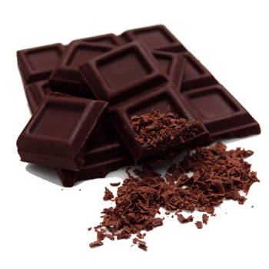
7. Dark Chocolate
Dark chocolate has typically 2-3 times
more cocoa as milk chocolate
Rich source of flavanols which are potent
antioxidants
Clinical trials show it can:
  ↓ blood pressure
  ↓oxidation of LDL-cholesterol
  ↑blood flow
  Improve the action of insulin
Regular eaters of cocoa-containing foods have
lower rates of heart disease

Slide 18
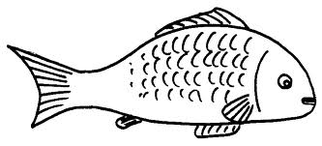
6. Fish
High in omega-3 fatty acids
Good sources: salmon, herring, sardines and capsules
Edible bones for calcium
Offers protection against:
  Heart disease (stops blood from clotting, improves heart beat rhythm, lower blood fats)
  Rheumatoid arthritis (anti-inflammatory)
  Mental health: depression, ADHD
  Dementia, Alzheimer’s

Slide 19
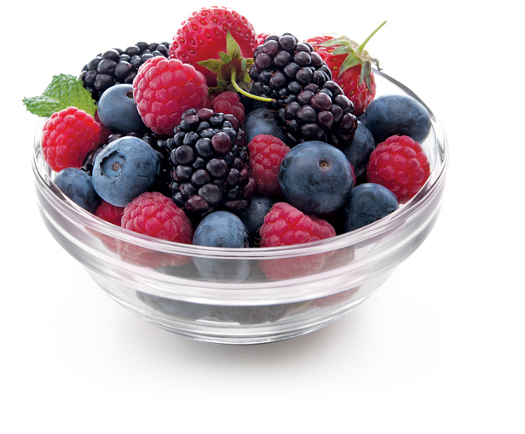
5. Berries
Includes blueberries, blackberries,
cranberries, raspberries, strawberries
and even goji and acai berries
Fibre
High in antioxidants and polyphenols
Three servings per week linked with a lower risk of heart attacks

Slide 20
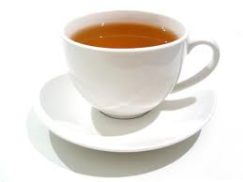
4. Tea
Rich in flavonoids (a class of polyphenols
that have antioxidant activity)
May slow cancer growth and lower heart disease
Black and green tea are both good, though greater evidence for green tea for heart disease
Some evidence of anti-depressant effects
Good source of ‘water’

Slide 21
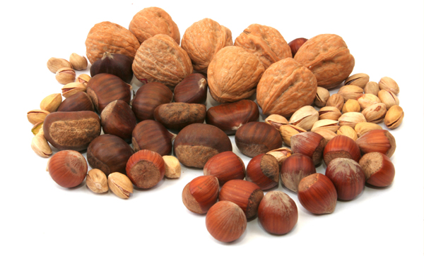
3. Nuts and Seeds
High in ‘good’ mono- and poly-
unsaturated fat
High in vitamin E
Good source of fibre and protein
Associated with favourable body weight outcomes
Linked with heart disease and diabetes protection

Slide 22
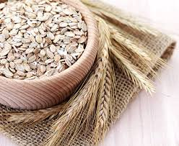
2. Oats
Good source of protein and
B-group vitamins
Low in fat
Great source of fibre for keeping blood sugar and cholesterol levels under control
Help with feelings of ‘fullness’ after a meal

Slide 23
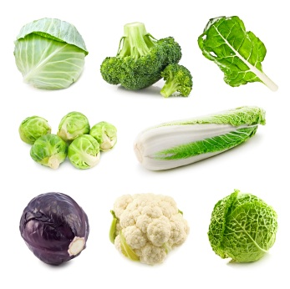
1. Cruciferous Vegetables
Broccoli, cauliflower, turnips,
Brussels sprouts, kale, bok choy,
cabbage, and radishes
Broccoli: vitamins A, C, B group, and fibre
Potent cancer protection: inactivate cancer-causing molecules and act as antioxidants

Slide 24
Tips for Food Variety
There are over 50 different types of fruits and vegetables available any time of the year
Go nuts for nuts
Choose recipes with lots of ingredients
Alternate your breakfasts

Slide 25

Food Variety Challenge
How many different foods do you eat each day?
30 is the target
The average Australian eats between 15 and 18

Slide 26





www.facebook.com/thinkingnutrition
www.thinkingnutrition.com.au
@CroweTim
tim.crowe@deakin.edu.au

Slide 27
QUESTIONS
Presented by
Tim Crowe
2 March 2016

