Slide 1
WELCOME TO OUR 2015
SYDNEY ALUMNI SEMINAR
Creating and Enabling Innovation at Work
Presented by
Steve Vamos
TWITTER: @stevevamos
12 August 2015

Slide 2
World has changed with significant Implications
Change is the main game
Its all about people – the human dimension
If we want to create and enable innovation at work we must think differently and do things differently
Need to be obsessive about people and deeply involve and align them in creating the future

Slide 3
Our changing World

Slide 4
Old mindsets – old thinking
Industrial - Age “of division”
Control
Mistakes are unacceptable
Know the answer

Slide 5
New mindsets – new thinking
Industrial Age “of division”
Digital Age “of the network”
Control
Mistakes are unacceptable
Know the answer
Enable, help, care
Try new things and be willing to fail
Open to learning

Slide 6
“Must Do’s” that require OBSESSION
Purpose: “Why are we here, what business are we in?”
Ambition: “What is possible?”
Alignment: With strategy and change agenda
Care: People management number 1
Confront: Hard conversations and decisions

Slide 7
Leading Change & Innovation the “iceberg”
Have
Do
Think
Feel

Slide 8
The “deeper” why
Overcoming Fear
Building a REAL sense of belief
Showing you care

Slide 9
Five fears ……
Not knowing the answer/being wrong
Failure - making mistakes or not being good
enough
Hurting someone's feelings/not being liked
Saying no to a good idea or request
Confronting reality

Slide 10
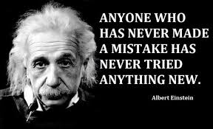

Slide 12
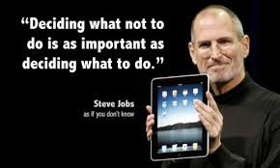

Slide 13
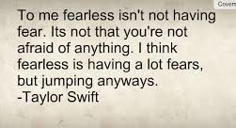

Slide 15
QUESTIONS
Presented by
Steve Vamos
TWITTER: @stevevamos

