Slide 1
Masters in Clinical Exercise Physiology (MCEP) Information Session: Burwood campus
A presentation by Prof Steve Selig
on behalf of the course team
Thursday, 6th June, 8 - 9 AM
Location: Lecture Theatre 3 (LT3)(b1.2.04)

Slide 2
Masters in Clinical Exercise Physiology (MCEP) Information Session: Waurn Ponds campus
A presentation by Prof Steve Selig
on behalf of the course team
Thursday, 6th June, 1 – 2 PM
Location: REACH Lecture Theatre (dd2.101)

Slide 3
The MCEP Course Team
Prof Steve Selig, AEP, PhD
Dr Steve Fraser, AEP, PhD
Dr Natalie Saunders, AEP, PhD
Dr Dawson Kidgell, PhD
Dr Andrew Dawson, PhD
Ms Niamh Mundell, AEP, M.Appl.Sci- Ex Rehab
Ms Louise Conway, AEP
Ms Alan Wallis, AEP

Slide 4
This session is about ….
This lecture/workshop will be presented by Prof. Steve Selig, course director for the Masters in Clinical Exercise Physiology (MCEP). As such this will be particularly interesting and relevant to students taking the ESSA major sequence of the Bachelor of Exercise and Sport Science H343.
During this lecture, Steve will give a presentation about the MCEP degree and provide some examples of case studies as they are taught within the MCEP programme.

Slide 5
Master of Clinical Exercise Physiology (H743): OVERVIEW
FIRST and ONLY clinical exercise course in Victoria to achieve accreditation with Exercise & Sports Science Australia (ESSA); articulated with the ESSA-accredited Bachelor of Exercise & Sports Science (H343) at Deakin
Simple pathway to accreditation as Accredited Exercise Physiologists (AEP)
AEPs are the only exercise professionals in Australia to have access to Provider Numbers with Medicare Australia, WorkSafe Victoria, DVA, TAC, and many other compensable funds and schemes
All students enrol as Commonwealth-Supported Places (CSP), making the course fees amongst the lowest in Australia. Course is 18 months full-time.

Slide 6
Master of Clinical Exercise Physiology (H743): OVERVIEW
The course team has expertise across all of the pathology areas needed for AEP accreditation.
The clinical practicum program covers all of the requirements for AEP accreditation and features the award winning Clinical Exercise Learning Centre at the Burwood campus, where students develop their practice skills under close supervision and mentoring. External placements too. All placements are arranged by Deakin University.
Outstanding levels of teaching excellence, clinical supervision, learning outcomes and employment in the sector.

Slide 7
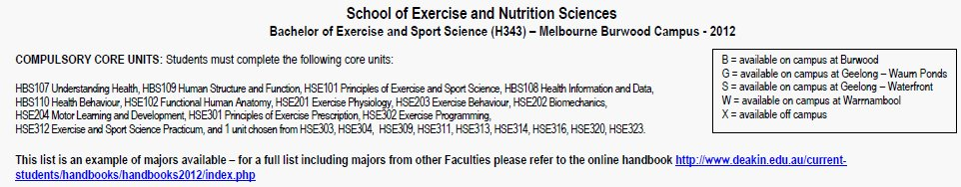
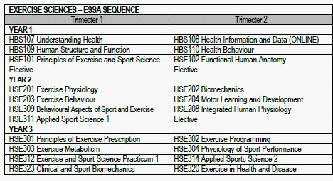
ESSA stream in the Bachelor of Exercise & Sports Science (H343)

Slide 8
Strong transition from Clinical Exercise Science to Clinical Exercise Practice to work

Slide 9
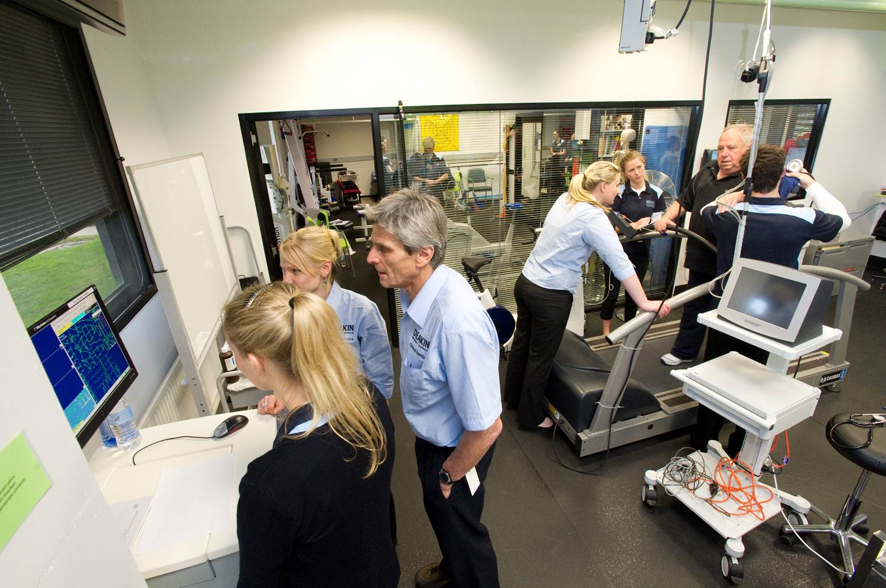

Slide 10
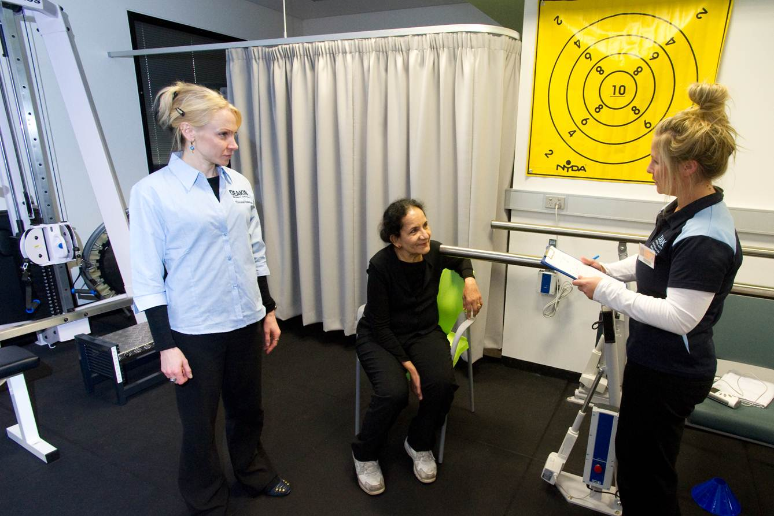

Slide 11
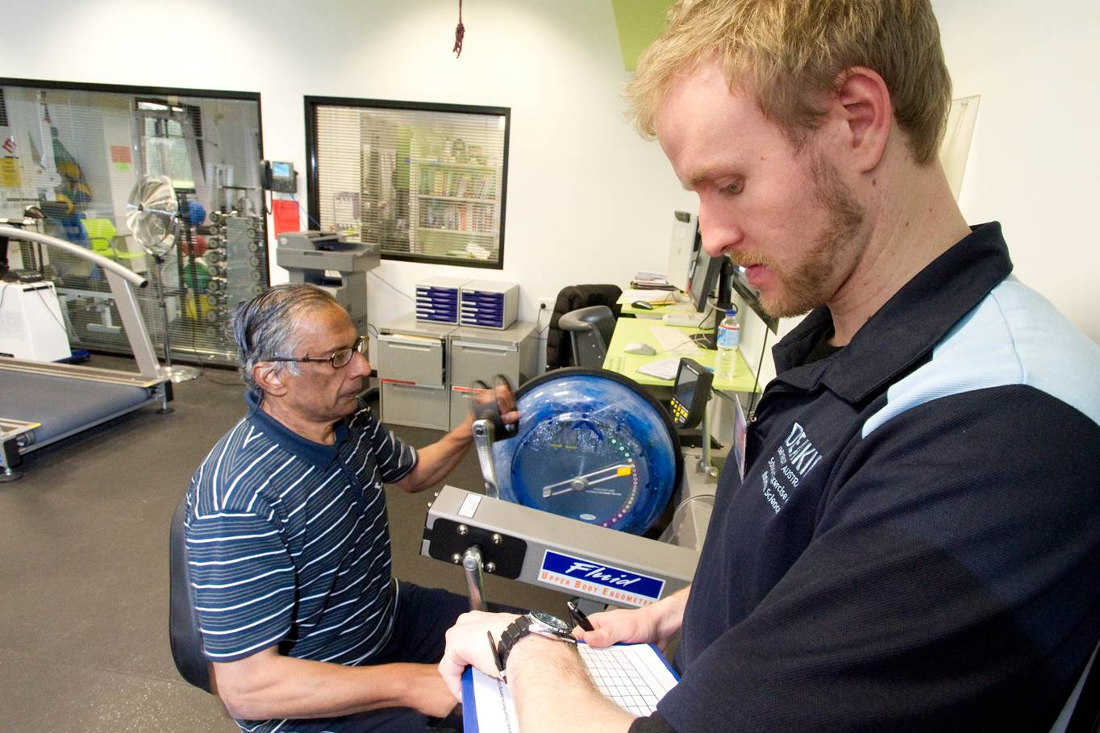

Slide 12
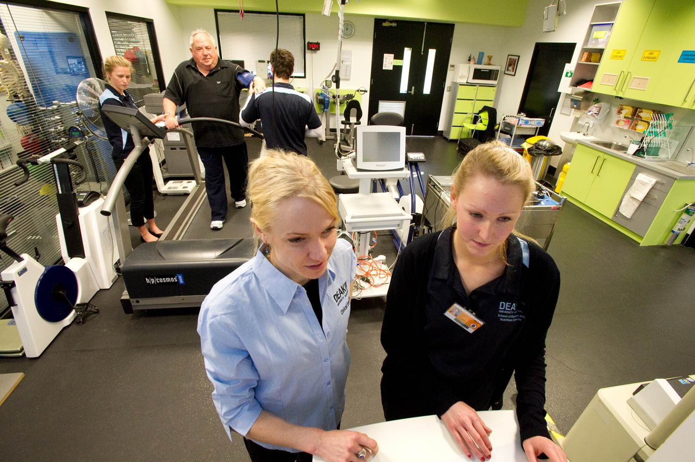

Slide 13
What does the accredited exercise physiologist (AEP) do?
The AEP uses exercise “therapy” to improve clients’:
Clinical status (through 1⁰ and 2º prevention, and rehabilitation)
Functional status (eg ADLs, fitness)
Psychosocial status (↓anxiety and symptoms of depression, ↑quality of life)
Evidence-Based Practice is the cornerstone

Slide 14
Exercise is medicine …..
Medicare Australia (and other national health systems) will be bankrupted by the burden of chronic disease if lifestyle medicine does not supplement conventional medicine.
Lifestyle medicine ⇒↓↓$$ compared to conventional medicine
Exercise is a “poly-pill” ⇒ ↓ obesity, ↑ insulin sens^{y}, ↓ lipids, ↓ blood pressure, ↓ anxiety + depression, ↓ mortality
No client ever wants to take
another pill or have another operation
Why is exercise therapy needed in Australia?
and the developed and developing world?

Slide 15
What are some differences between AEPs and physiotherapists?
The important differences between physiotherapists and AEPs are that physiotherapists focus on treating the primary medical condition(s) usually at the acute and post-acute stages, whereas AEPs apply exercise to improve their clients’ chronic clinical, functional and psychosocial status.
AEPs draw on an extensive range of high quality evidence to provide clinical exercise services for both the management and prevention of chronic disease.
For further information on clinical exercise practice, go to ESSA and Exercise is Medicine®

Slide 16
What are some differences between AEPs and physiotherapists?
Physiotherapists treat the primary problem, usually an injury, at the acute and early post-acute stages of rehabilitation.
AEPs treat the whole person, using exercise and other lifestyle strategies including health coaching. AEPs help people recovering from illness (eg heart attack), injury (soft tissue) or an operation (eg hip replacement), with a goal to helping clients to help themselves to better long term health and
fitness (prevention).

Slide 17
Do AEPs earn the same as physiotherapists?
Yes, when these health professionals are employed by hospitals.
Both enter their professions at Grade I, with equal salary and status. They can then progress in their careers from there.
The billing charges under Medicare, WorkSafe and other compensable schemes are very comparable for physiotherapists and AEPs

Slide 18
Careers as an AEP
Hospital rehabilitation
  Restoration of function and 2⁰ prevention for in-patients and out-patients
Medical rehabilitation
  1⁰ and 2⁰ prevention, and restoration of function for patients referred by medical practitioners
Occupational rehabilitation
  Return to work programs (RTW)
  Injury Prevention ⇔ Work Conditioning
Community rehabilitation
  1⁰ and 2⁰ prevention, and restoration of function for clients
  referred by medical practitioners/physiotherapists/
  self-referred
  Aged Care and Fitness facility clientele

Slide 19
Careers as an AEP cont.
Sports rehabilitation
  Return to training and competition for injured athletes
  Injury Prevention ⇔ Conditioning
Case Management
  Human Resources Departments
  OH&S Departments
  Insurers
  Decision and Policy Makers
AEP academic (universities)
  AEPs who also complete a PhD in clinical exercise

Slide 20
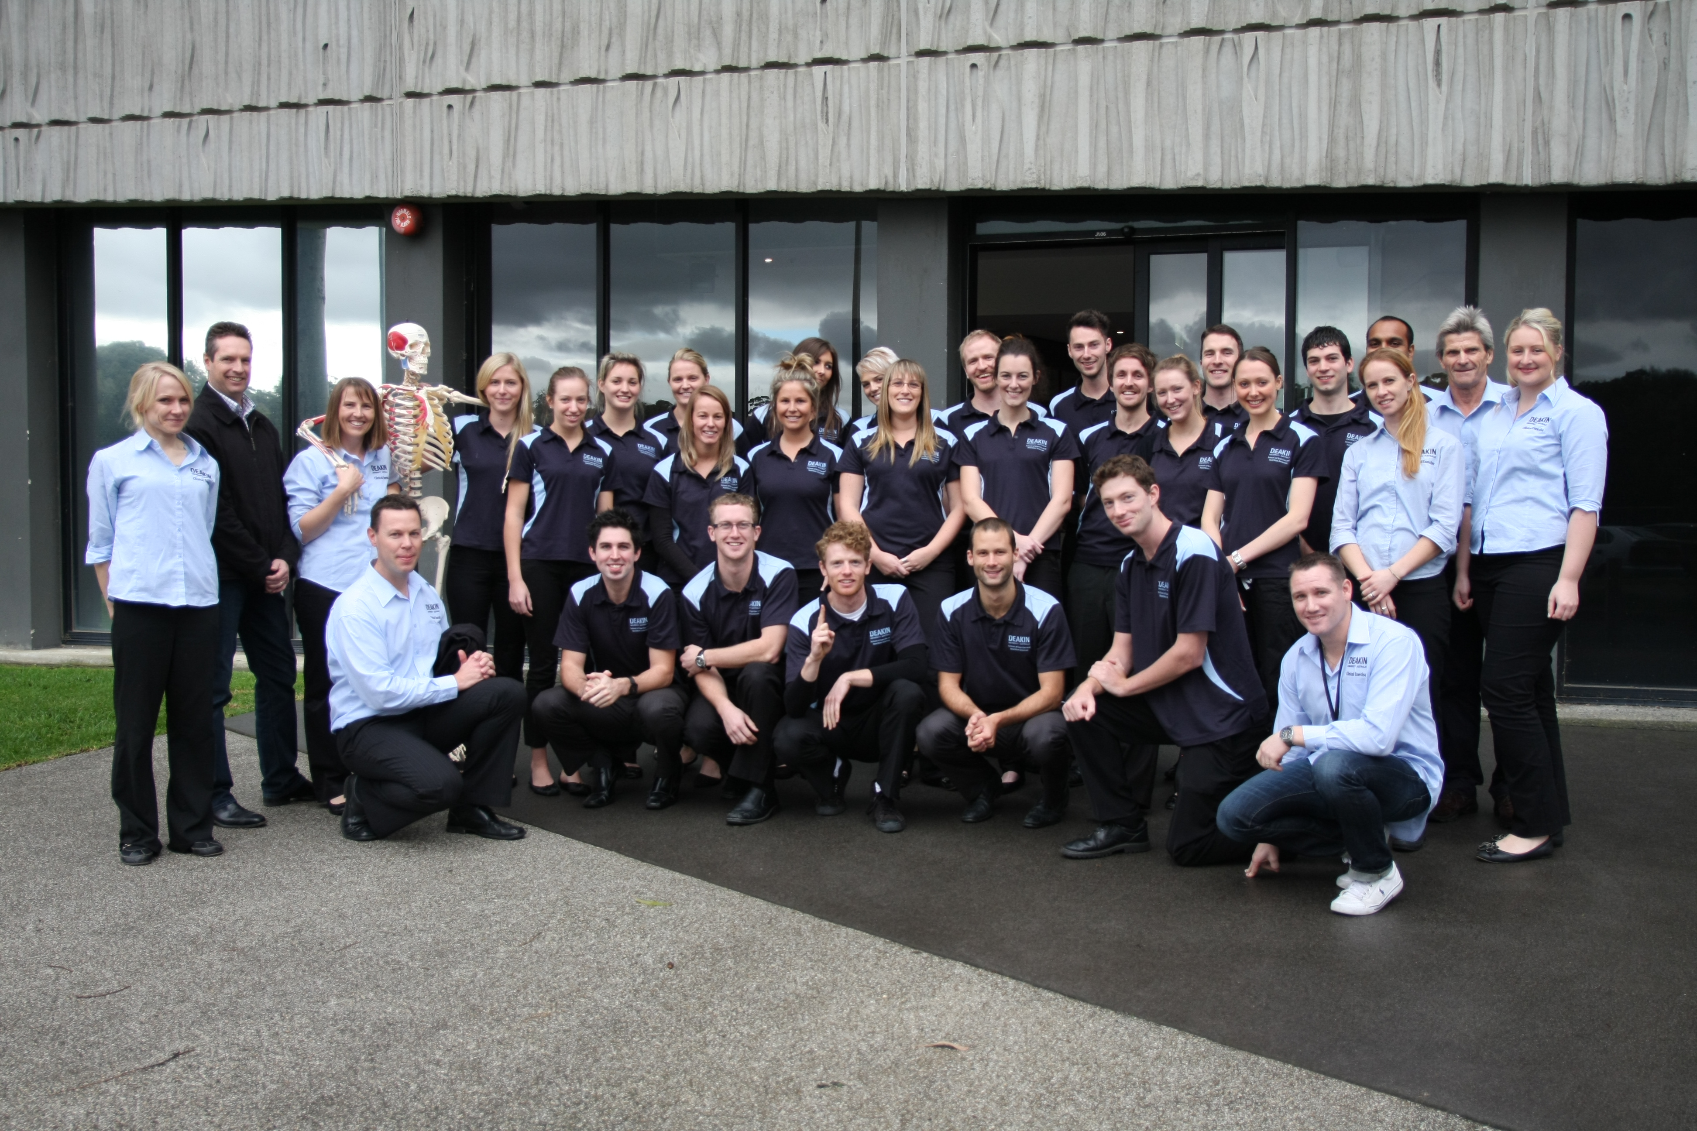
Class of 2012: where are they now?
PACE Exercise Physiology
MD Health Physiotherapy
Epworth Health
Epworth Health
CGU Insurance
Donvale Private Hospital
Active One
Peninsula Health & Nutrition
Rowville Sports Medicine
Bounce Health Group
Deakin University

Slide 21
What students say about the course
“The Masters of Clinical Exercise Physiology at Deakin University is a great course and provided me with countless opportunities which have been invaluable for getting me into the position I am today.”
“I managed to land a job with ???? where I did my placement.”
“I chose to do the Masters of Clinical Exercise Physiology at Deakin because it was designed by some of the most respected AEPs in the country. The small size of the classes gives you access to the lecturers who are all AEPs and are leaders in their fields. I believe completing the MCEP course at Deakin helped me get my to where I am today.”
“I am amazed at how much information we have absorbed during the course and am feeling very confident in now dealing with clients who present with such pathologies.”
“It is fantastic that we get to work with real clients in classes; this really strengthens the learning of conditions and practical skills.”

Slide 22
Entry Criteria
Applicants must be eligible for FULL membership of Exercise & Sports Science Australia (a necessary pre-requisite for AEP accreditation) and have completed 140 hours of exercise service delivery for apparently healthy clientele. Entry criteria are ANY of these:
1. Graduates of the ESSA Stream in the Bachelor of Exercise & Sports Science (H343) at Deakin University after 2010: this course is accredited at the Exercise Science level by ESSA and is designed to provide direct entry into the Masters (H743);
2. Applicants who have previously completed an ESSA accredited undergraduate degree in Exercise Science at another university: go to ESSA to see the list of accredited universities;
3. Graduates of undergraduate degrees other than those above who can demonstrate that they covered all or most of the elements required for full membership of ESSA;
4. ESSA Graduate Student Members are eligible for full membership of ESSA; go to ESSA to download the application form for ESSA Graduate Student Membership;
5. Current or past full member of ESSA.

Slide 23
Selection Criteria
Satisfying the entry criteria PLUS
GPA, WAM (or equivalent) of *Distinction average (≈70%) for a suitable undergraduate qualification
Work experience and/or other attributes that demonstrate suitability for the course and the profession of an AEP
Some applicants may be invited to interview prior to offers for entry into the course
*students with lower GPAs are also encouraged to apply if they can demonstrate other strong attributes (eg passion for work as an AEP); however they will be assessed alongside students with higher GPAs

Slide 24
Exercise service delivery for apparently healthy clientele: approved activities
Screening and risk management
Assessment of client
  Exercise capacities
  Functional capacities (eg vocational / occupational, recreational, activities of
  daily living)
  Psychosocial assessments in relation to exercise and physical activity, including maintenance
Planning of exercise interventions:
  Goal setting: client and practitioner; others (eg health professionals)
  Identifying barriers and facilitators for exercise and physical activity
  Providing solutions for barriers
  Designing exercise interventions

Slide 25
Approved activities continued
4. Delivery of exercise interventions:
  Teaching correct technique and coaching
  Motivation
  Self-management
  Program management: eg daily / weekly planner
5. Evaluation of exercise interventions:
  pre vs. post intervention assessments
  Practice efficacy data

Slide 26
School Careers’ Website
www.deakin.edu.au/ens/careers

Slide 27
More information for Master of
Clinical Exercise Physiology (H743)
Professor Steve Selig (Course Director)
steve.selig@deakin.edu.au 0418 570 772
Dr Steve Fraser (Deputy Course Director)
steve.fraser@deakin.edu.au 9244 6012

