Slide 1
Master of Clinical Exercise Physiology at Deakin
A presentation by Prof Steve Selig
on behalf of Deakin University Clinical Exercise (DEUCE)

Slide 2
Deakin University
Clinical Exercise (DEUCE)
Members of DEUCE:
Prof Steve Selig, AEP, PhD
Dr Steve Fraser, AEP, PhD
Dr Natalie Saunders, AEP, PhD
Dr Dawson Kidgell, PhD
Dr Andrew Dawson, PhD
Ms Karen Salter, AEP, M.Appl.Sci- Ex Rehab
Ms Niamh Mundell, AEP, M.Appl.Sci- Ex Rehab
Ms Unna Goldsworthy, AEP, Grad Dip – Ex Rehab
Ms Helen Donovan, BSc – Psych, Grad Dip - Psych

Slide 3
Overview
Course Structure
How to Apply
What do AEPs do?
Careers as an AEP
Compensable Schemes available to AEPs
More information

Slide 4
H743 Course Structure
Trimester 1
HSE703 Exercise Behaviour and Motivation
HSE705 Exercise Physiology for Cardiopulmonary Disease
HSE707 Exercise Physiology for Musculoskeletal Injury and Disease
HSE711 Pre Clinical Practice 1
Trimester 2
HSE702 Exercise Physiology for Neurological and Neuromuscular Disease
HSE704 Exercise Physiology for Metabolic Disease
HSE712 Pre Clinical Practice 2
HSE714 Clinical Practicum 1

Slide 5
H743 Course Structure continued
Trimester 3
HBS745 Interprofessional Collaboration in Health Care
HSE709 Exercise Physiology for Special Populations
HSE715 Clinical Practicum 2
HSE717 Clinical Practicum 3
Notes on practicum:
Applicants for the Masters MUST have completed 140 hours of exercise service delivery for apparently healthy clientele PRIOR to application for entry.
All the remaining clinical practicum is included in the course structure and so graduates will be eligible to
apply for AEP accreditation on graduation.

Slide 6
Strong transition from Clinical Exercise Science to Clinical Exercise Practice to work

Slide 7
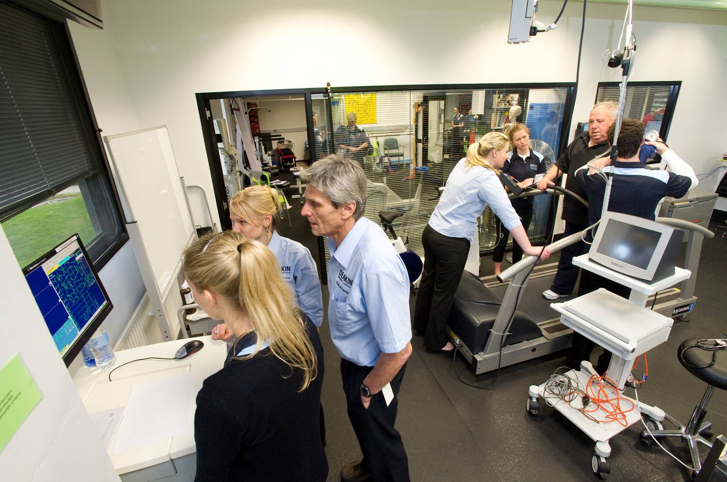

Slide 8
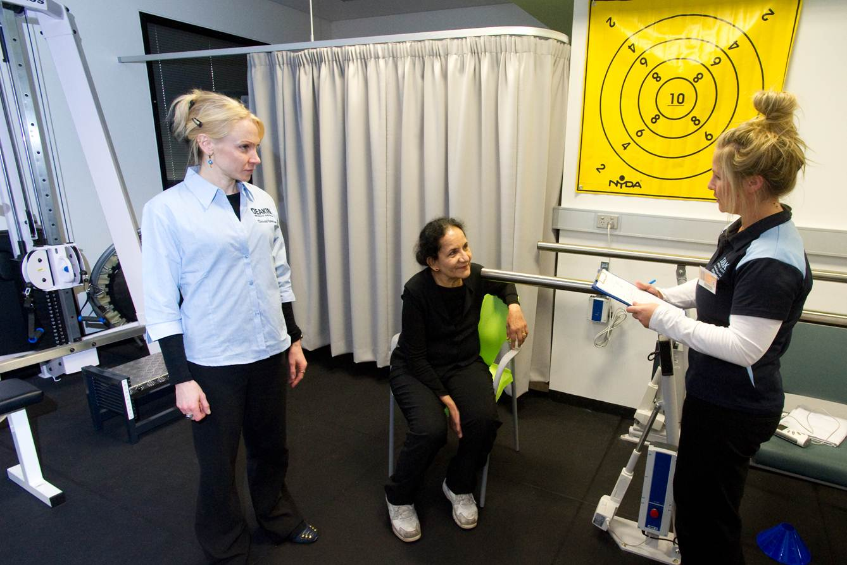

Slide 9
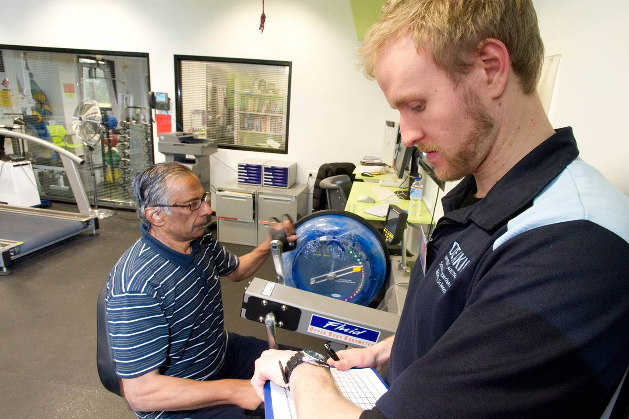

Slide 10
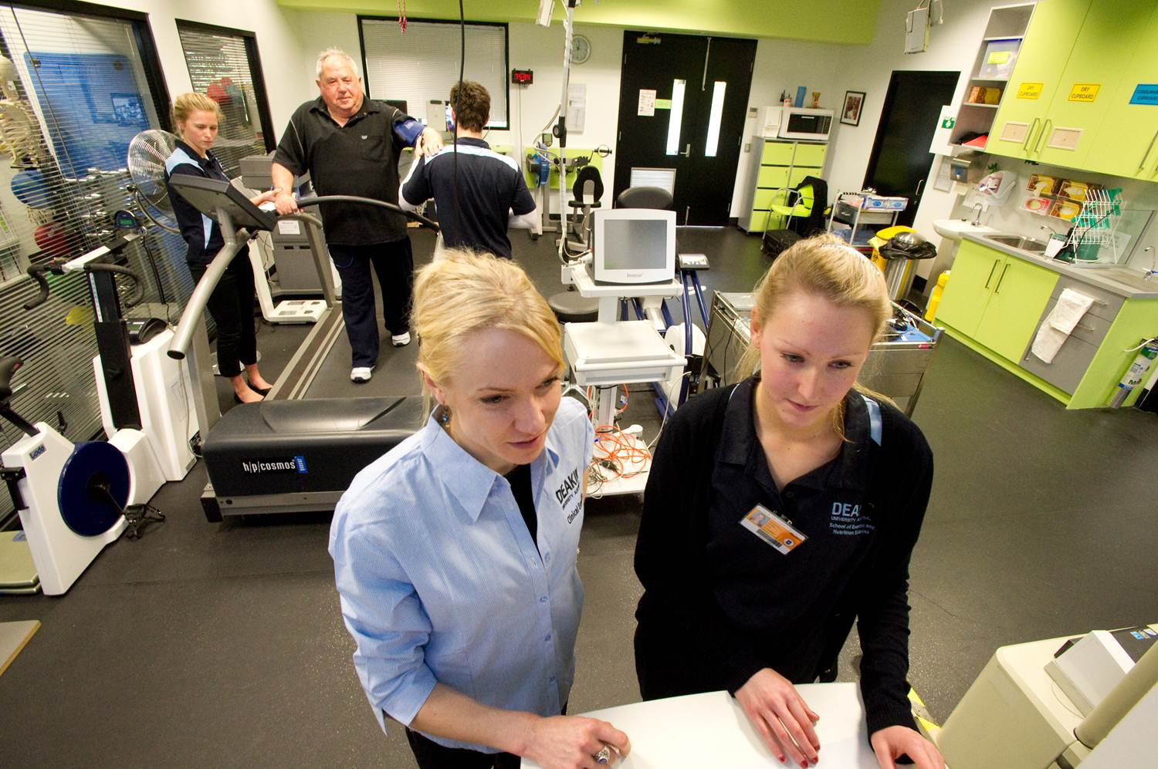

Slide 11
Aims of the Master of
Clinical Exercise Physiology
All graduates of the Masters will:
possess the necessary knowledge, competencies and clinical experience to become an AEP
be able to deliver safe and effective exercise services for clientele with chronic conditions and injuries;
understand the effects of acute and chronic exercise for people with chronic medical conditions and complex care needs;
engage with the profession through ESSA and other professional activities
have developed skills and habits for lifelong
independent learning to enable them to continue to
develop as practitioners

Slide 12
How to Apply
Entry Criteria:
a. Graduate Student Member of ESSA* PLUS evidence of 140 hours of exercise service delivery for apparently healthy clientele
OR
b. Applicants who have graduated from an ESSA NUCAP accredited program in Exercise Science** (strict eligibility rules apply) PLUS evidence of 140 hours of exercise service delivery for apparently healthy clientele
OR
c. Current Exercise Scientist/Full Member of Exercise and Sports Science Australia (ESSA) PLUS evidence of 140 hours of exercise service delivery for apparently healthy clientele
* ESSA has a graduate student membership category (this is not the same as the student membership category available to undergraduate students); graduate student membership will guarantee you FULL membership of ESSA after graduation from the Master of Clinical Exercise Physiology (H743) and then automatic AEP accreditation. Membership application form can be downloaded from http://www.essa.org.au/
** Deakin University graduates of Bachelor Exercise and Sport Science (ESSA Stream) are eligible under this option

Slide 13
Exercise service delivery for apparently healthy clientele: approved activities
Screening and risk management
Assessment of client
  Exercise capacities
  Functional capacities (eg vocational / occupational, recreational, activities of
  daily living)
  Psychosocial assessments in relation to exercise and physical activity, including maintenance
Planning of exercise interventions:
  Goal setting: client and practitioner; others (eg health professionals)
  Identifying barriers and facilitators for exercise and physical activity
  Providing solutions for barriers
  Designing exercise interventions

Slide 14
Approved activities continued
4. Delivery of exercise interventions:
  Teaching correct technique and coaching
  Motivation
  Self-management
  Program management: eg daily / weekly planner
5. Evaluation of exercise interventions:
  pre vs. post intervention assessments
  Practice efficacy data

Slide 15
Cover Letter
Academic background, including university courses completed and grade point average (WAM, GPA, or equivalent)
Relevant work experience, including the roles and responsibilities undertaken
Statement articulating your reasons for wanting to become an Accredited Exercise Physiologist (AEP)

Slide 16
Selection Criteria
Satisfying the entry criteria PLUS
GPA, WAM (or equivalent) of Distinction average for a suitable undergraduate qualification
Work experience and/or other attributes that demonstrate suitability for the course and the profession of an AEP
Some applicants may be invited to interview prior to offers for entry into the course

Slide 17
Master of Clinical Exercise: external accreditation
The Master of Clinical Exercise Physiology (H743) now has preliminary accreditation with the National University Course Accreditation Program (NUCAP)
We submitted our application for FULL accreditation in Dec 2011; this should be approved before you graduate
FULL accreditation will permit automatic AEP accreditation for graduates provided that
  you are able to provide completed Clinical Practicum Logbooks: 140 hours cardiorespiratory / metabolic, PLUS 140 hours musculoskeletal / neuromuscular / neurological, PLUS 80 hours “other” clinical experiences PLUS 140
  hours of exercise service delivery for apparently healthy clientele
  (latter is needed PRIOR to application for entry)

Slide 18
What does the accredited exercise physiologist (AEP) do?
The AEP uses exercise “therapy” to improve clients’:
Clinical status (through 1⁰ and 2º prevention, and rehabilitation)
Functional status (eg ADLs, fitness)
Psychosocial status (↓anxiety and symptoms of depression, ↑quality of life)
EBP is the cornerstone

Slide 19
Exercise is medicine …..
Medicare Australia (and other national health systems) will be bankrupted by the burden of chronic disease if lifestyle medicine does not supplement conventional medicine.
Lifestyle medicine ⇒↓↓$$ compared to conventional medicine
Exercise is a “poly-pill” ⇒ ↓ obesity, ↑ insulin sens^{y}, ↓ lipids, ↓ blood pressure, ↓ anxiety + depression, ↓ mortality
No client ever wants to take
another pill or have another operation
Why is exercise therapy needed in Australia?
and the developed and developing world?

Slide 20
Dream outcomes for the AEP
Category | Outcome
Clinical Status | disease progression risk factors medications +/- doses risk of new diagnosis hospitalisations ↑ knowledge of condition, ↑ motivation, ↑ self-management
Function (fitness) | Long term “healthy addiction” to exercise ↑ injured worker rehabilitation ↑ independent living Return to sport outcomes
Quality of life | medications +/- doses (anti-depressants, sleep) risk of depression

Slide 21
Target Pathologies
> 1% prevalence in Australia and evidence base for exercise therapy
Category | Condition
Cardiopulmonary | Hypertension (HT), coronary artery disease (CAD), peripheral vascular disease (PVD), myocardial infarction AMI), chronic heart failure (CHF), asthma, COPD, cystic fibrosis (CF)
Metabolic | Obesity, dyslipidaemias, impaired glucose tolerance (IGT), diabetes mellitis (DM)
Musculoskeletal | Arthritides (esp. OA and RA), osteoporosis (OP), sub-acute and chronic specific and non-specific musculoskeletal pain / injuries, surgery, epicondylitis, tendinopathies
Neurological / Neuromuscular | Stroke (CVA), spinal cord injury (SCI), acquired brain injury (ABI), Parkinson’s Disease, Multiple Sclerosis (MS)
Other | Cancers, Depression
The list is not meant to be exhaustive: AEPs are accredited on competencies for these, but practise also in other pathologies (e.g. CFS)

Slide 22
What are some differences between AEPs and physiotherapists?
Physiotherapists treat the primary problem, usually an injury, at the acute and early post-acute stages of rehabilitation.
AEPs treat the whole person, using exercise and other lifestyle strategies including health coaching. AEPs help people recovering from illness (eg heart attack), injury (soft tissue) or an operation (eg hip replacement), with a goal to helping clients to help themselves to better long term health and
fitness (prevention).

Slide 23
Do AEPs earn the same as physiotherapists?
Yes, when these health professionals are employed by hospitals.
Both enter their professions at Grade I, with equal salary and status. They can then progress in their careers from there.
The billing charges under Medicare, WorkSafe and other compensable schemes are very comparable for physiotherapists and AEPs

Slide 24
Careers as an AEP
Hospital rehabilitation
  Restoration of function and 2⁰ prevention for in-patients and out-patients
Medical rehabilitation
  1⁰ and 2⁰ prevention, and restoration of function for patients referred by medical practitioners
Occupational rehabilitation
  Return to work programs (RTW)
  Injury Prevention ⇔ Work Conditioning
Community rehabilitation
  1⁰ and 2⁰ prevention, and restoration of function for clients
  referred by medical practitioners/physiotherapists/
  self-referred
  Aged Care and Fitness facility clientele

Slide 25
Careers as an AEP continued
Sports rehabilitation
  Return to training and competition for injured athletes
  Injury Prevention ⇔ Conditioning
Case Management
  Human Resources Departments
  OH&S Departments
  Insurers
  Decision and Policy Makers
AEP academic (universities)
  AEPs who also complete a PhD in clinical exercise

Slide 26
Compensable Schemes available to AEPs
(all achieved since 2006)
Medicare (Aust.)
WorkCover (Qld, NSW, WA, SA, ACT) / WorkSafe (Vic)
TAC
Veterans Affairs
Comcare (Commonwealth Workers Health Scheme)
Private Insurers
Others to come

Slide 27
Private Health funds recognise
Exercise Physiology Services
AHM
CBHS
GMF Health
Medibank Private
MBF
Teachers Federation Health
GU Health
Australian Unity
NIB
HBF
HCF
Reserve Bank

Slide 28
School Careers’ Website
www.deakin.edu.au/ens/careers

Slide 29
More information for Master of
Clinical Exercise Physiology (H743)
Professor Steve Selig (Course Director)
steve.selig@deakin.edu.au 0418 570 772
Dr Steve Fraser (Deputy Course Director)
steve.fraser@deakin.edu.au 9244 6012

Slide 30
Graduate student membership of ESSA
Cost: $88/yr: this fee includes an assessment of your undergraduate credentials for future FULL membership of ESSA that is required in order for you to become an AEP
You do NOT need to be FULL member of ESSA whilst studying the Master of Clinical Exercise Physiology (H743).
Benefits of graduate student membership of ESSA:
  enhance your CV!!
  access to professional network,
  professional indemnity insurance,
  ESSA magazine, journals, discounted conferences, seminars
  emails on current positions in exercise and Sports Science
How to register: download form www.essa.org.au
Or contact ESSA university liaison: steve.fraser@deakin.edu.au

