Slide 1
Rock the boat submission
LCDR Col Painter
LCDR Chris Thornton

Slide 2
Thinking Fire Fighters

Slide 4
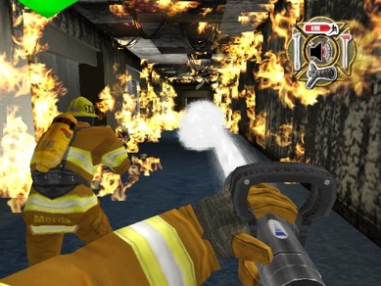
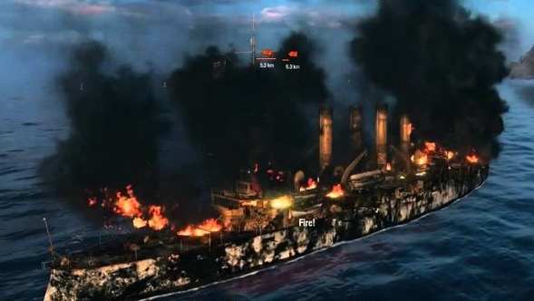

Slide 6
QUESTIONS?

