Slide 1
UNSW Art & Design
Designing a Simulation Training Ecosystem for
Cultural Shift and Transformational Change
Associate Professor Simon McIntyre
Navy, Industry and Academia Training Conference | 29-30 May 2019

Slide 2
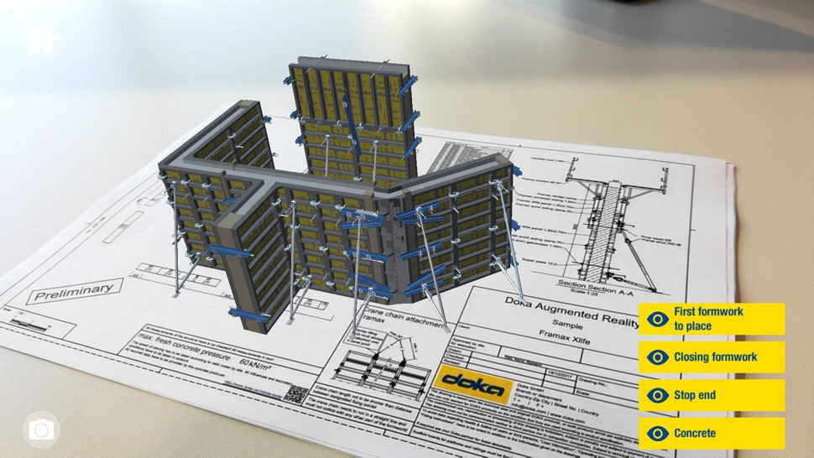
Doka.com. (2019). Doka Augmented and Virtual Reality App - Doka. [online] Available at: https://www.doka.com/me/home/apps/augmented-and-virtual-reality-app

Slide 3
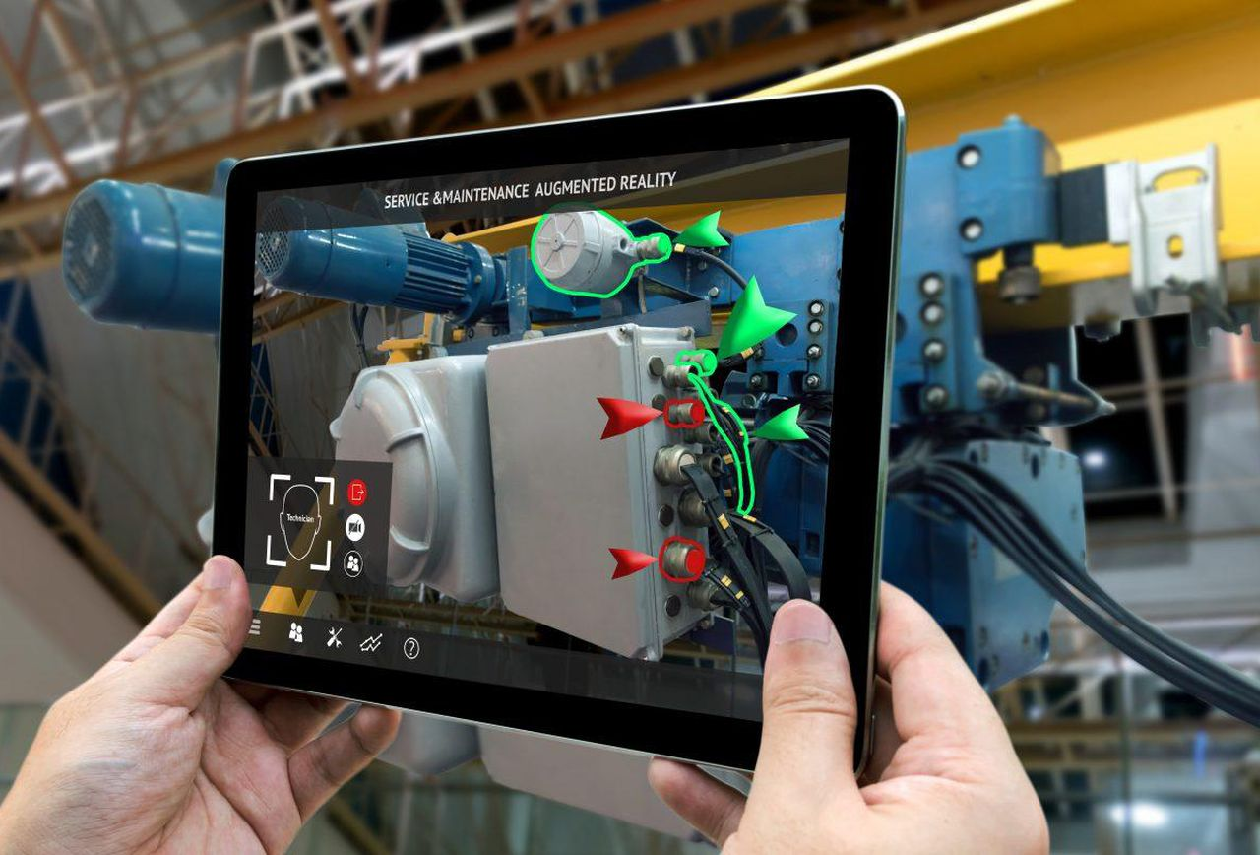
Doka.com. (2019). Doka Augmented and Virtual Reality App - Doka. [online] Available at: https://www.doka.com/me/home/apps/augmented-and-virtual-reality-app [Accessed 24 May 2019].
Forbes.com. (2019). 9 Powerful Real-World Applications Of Augmented Reality (AR) Today. [online] Available at: https://tinyurl.com/yxtbje6q

Slide 5
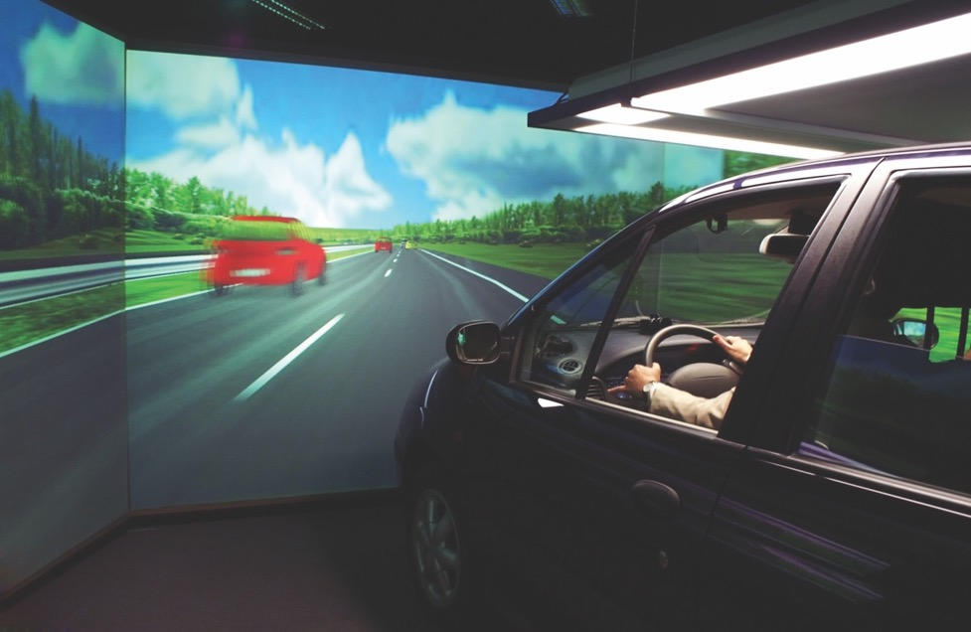

Slide 6
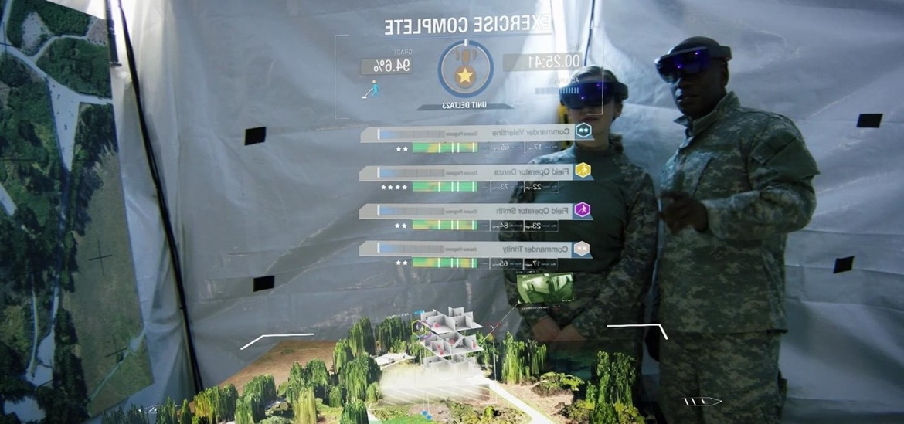

Slide 7
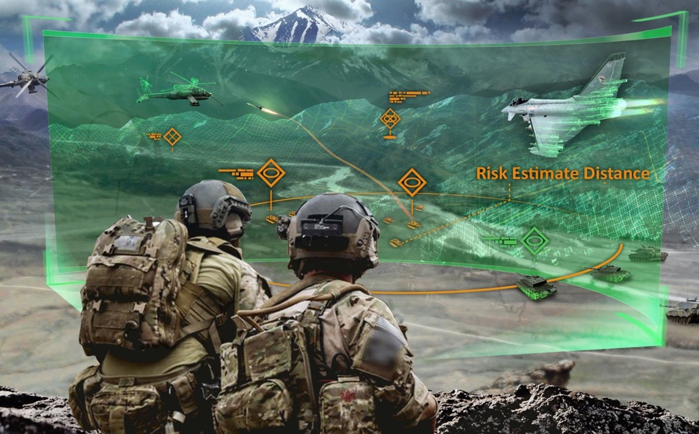

Slide 8
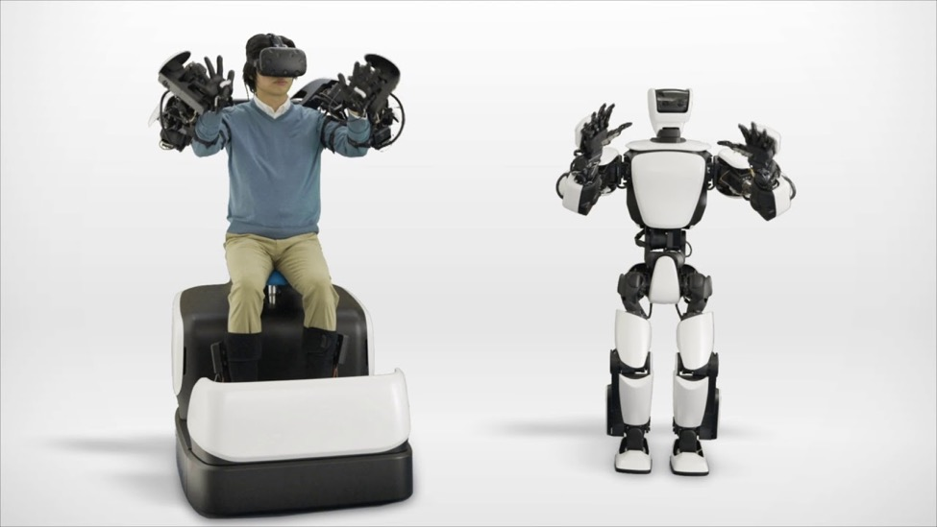
YouTube. (2019). Control The Humanoid Robot Using VR And Haptics. [online] Available at: https://www.youtube.com/watch?v=Eg2FUohljJY

Slide 9
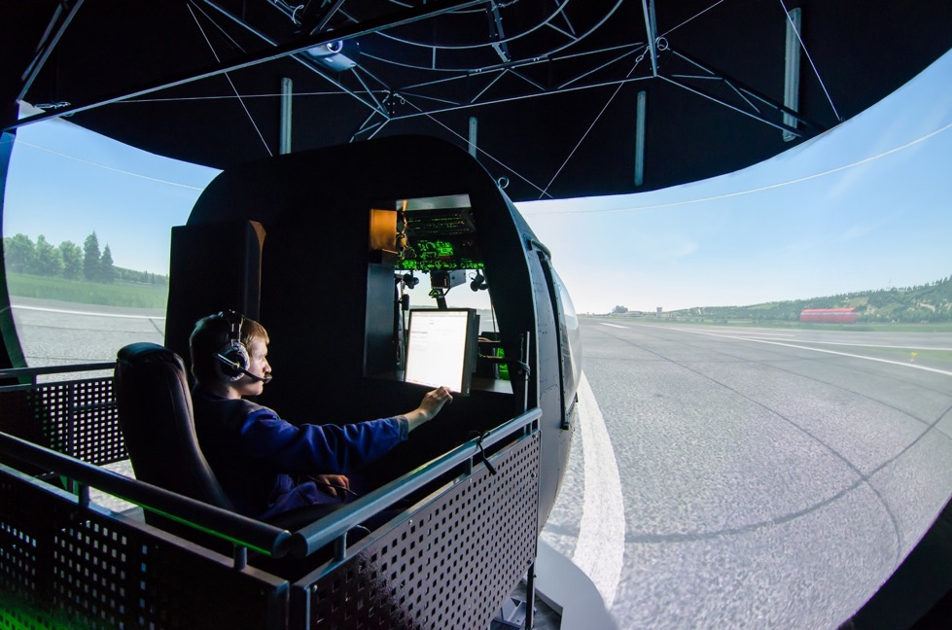

Slide 10
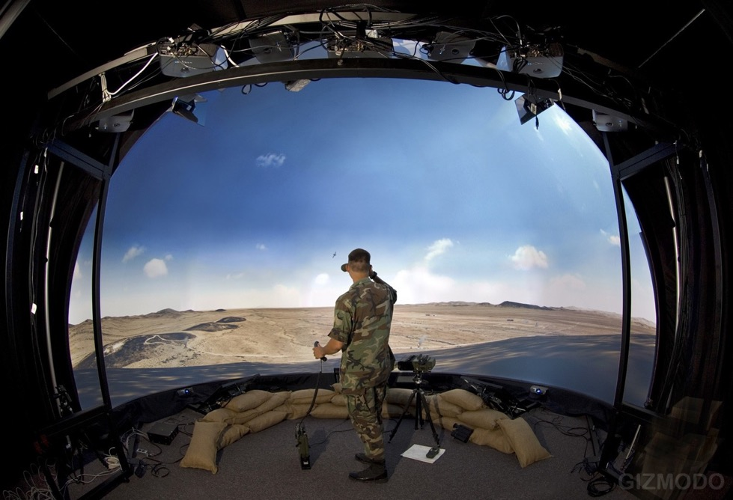

Slide 11
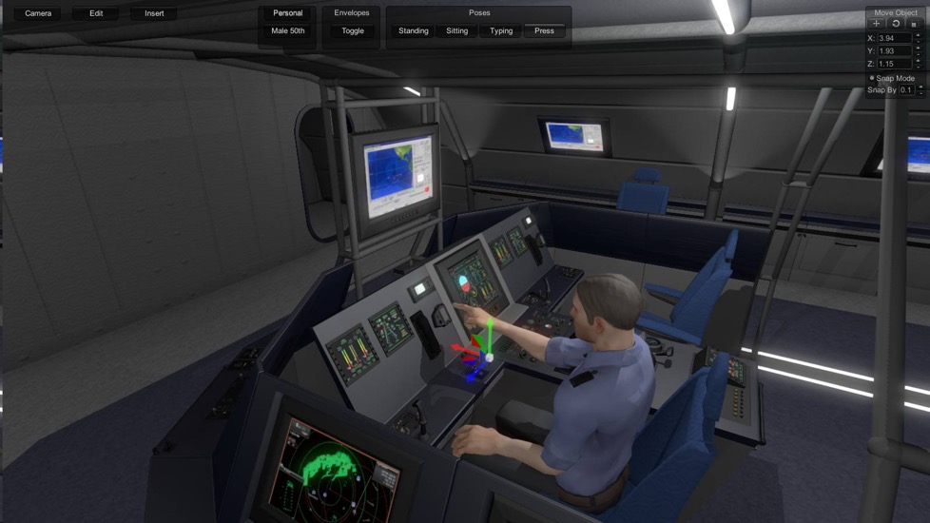
Themanufacturer.com. (2019). [online] Available at: https://tinyurl.com/y68e5233

Slide 12
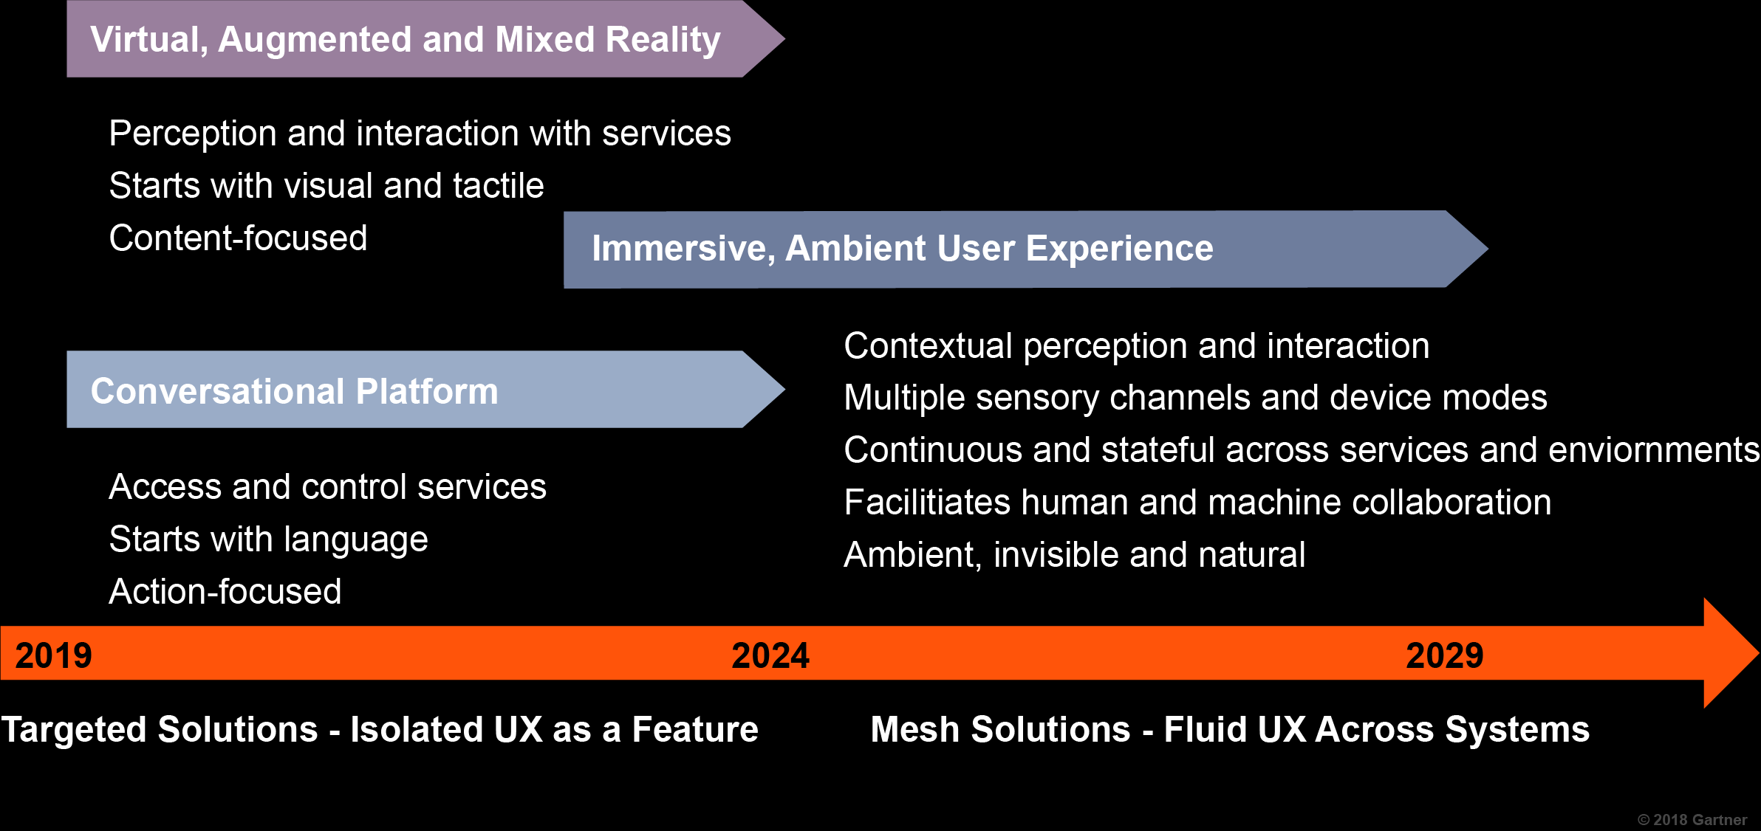
Cearley, D. and Burke, B. (2018). Top 10 Strategic Technology Trends for 2019. [online] Available at: https://tinyurl.com/y3oa9k43

Slide 13
Creating demand for upskilling and new qualifications
Can use to change or train for individual jobs – but why does it not get adopted more
Are we getting the most from this tech and how do we do it long term across an entire organisation?
Mycourses.aalto.fi. (2019). Course: CS-E5740 - Complex Networks, 12.09.2018-12.12.2018. [online] Available at: https://tinyurl.com/yyz6umq2

Slide 14
Creating demand for upskilling and new qualifications
Can use to change or train for individual jobs – but why does it not get adopted more
Are we getting the most from this tech and how do we do it long term across an entire organisation?
Mycourses.aalto.fi. (2019). Course: CS-E5740 - Complex Networks, 12.09.2018-12.12.2018. [online] Available at: https://tinyurl.com/yyz6umq2

Slide 15
Creating demand for upskilling and new qualifications
Can use to change or train for individual jobs – but why does it not get adopted more
Are we getting the most from this tech and how do we do it long term across an entire organisation?

Slide 18
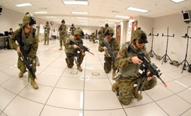
Jasoren.com. (2019). Virtual reality in military training — Jasoren. [online] Available at: https://tinyurl.com/y5pukyny

Slide 19
Individual
Human / Machine Immersion Data

Slide 20
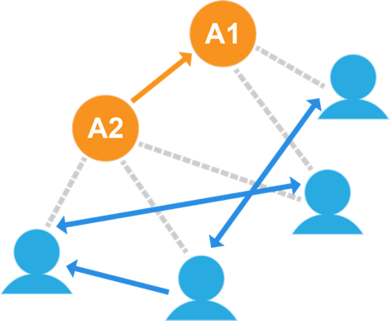
Group
Human / Machine Immersion Data
Individual
Parraguez, P. (2015). A networked perspective on the engineering design process: at the intersection of process and organisation architectures (Doctoral dissertation, PhD Thesis, Technical University of Denmark).

Slide 21
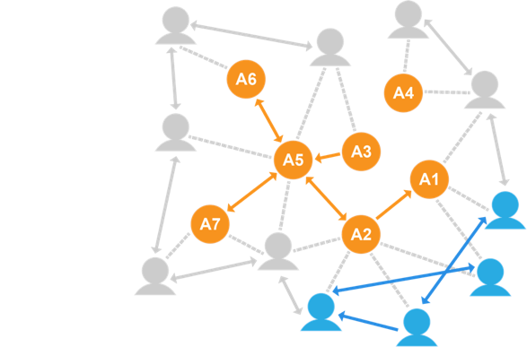
Organisation
Organisation
Human / Machine Immersion Data
Group
Individual
Parraguez, P. (2015). A networked perspective on the engineering design process: at the intersection of process and organisation architectures (Doctoral dissertation, PhD Thesis, Technical University of Denmark).

Slide 22
Integrated Organisational Immersive Training
Organisation
Human / Machine Immersion Data
Group
Design driven and data informed
Iteratively adapting to changes in network
Provides complete picture of training effectiveness
Enables targeted improvements in traditional processes
More focused, efficient and effective operations
Maximised capability
Individual

Slide 23
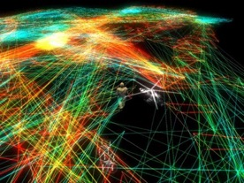
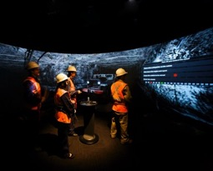
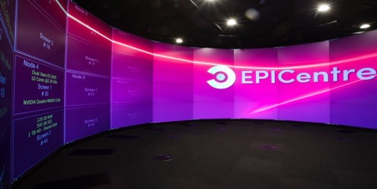
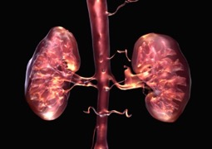
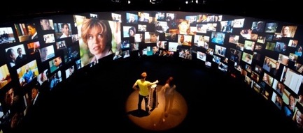
EPICentre (Expanded Perception & Interaction Centre)
Applied artificial intelligence
Computational simulation science
Mixed Reality lab (XR-LAB)
iCinema
AVIE
Intelligent Environments Lab
Ultra High Resolution Scanning Lab
National Facility for Human-Robot Interaction Research
Unique facility with 200 sensors to evaluate interpersonal and human-robot interaction, and new human-centred technologies
3D Visualisation Aesthetics Lab
VR visualisation of complex scientific and medical data
Creating demand for upskilling and new qualifications
Can use to change or train for individual jobs – but why does it not get adopted more
Are we getting the most from this tech and how do we do it long term across an entire organisation?

Slide 24
Visualisation, Simulation, and Immersive Design Ecosystem
Complexity and Wicked Problems
Human Centric
Design
Immersion Management
Human Dimensions in Immersive Environments
AI and Robotics
Designing and Experiencing Immersion
VR, AR, and MR
Models and Convergence
Simulation Design
Training and Skills
Systems and Solutions Design
Narrative and Sensemaking

Slide 25
Visualisation, Simulation, and Immersive Design Ecosystem
Servicing
Short Courses (micro-credentialed)
Individual
Skill Development
Typically 2-3 days

Slide 26
Visualisation, Simulation, and Immersive Design Ecosystem
Servicing
Short Courses (micro-credentialed)
Individual
Skill Development
Typically 2-3 days
Graduate Certificate & Masters
Group
Immersive Design
Grad Cert
Masters
0.3 years
1.7 years

Slide 27
Visualisation, Simulation, and Immersive Design Ecosystem
Servicing
Short Courses (micro-credentialed)
Individual
Skill Development
Typically 2-3 days
Graduate Certificate & Masters
Group
Immersive Design
Grad Cert
Masters
0.3 years
1.7 years
Consultation & Contract Research
Organisational
Training Strategy

Slide 28
artdesign.unsw.edu.au/VSID
Associate Professor Simon McIntyre
Associate Dean Education
UNSW Art & Design
s.mcintyre@unsw.edu.au
Dr Teresa Crea
Development & Education Lead
Visualisation | Simulation | Immersive Design
t.crea@unsw.edu.au
Alisha Fisher
Managing Director
Asia Pacific Simulation Alliance
alisha@asiapacificsimulationalliance.com

